Slide 1

NHA Advocacy Institute
Intro to Advocacy: The Why, How, Who

Slide 2

The Why: WE NEED YOU
To engage with policymakers, their staff, and other stakeholders to influence healthcare policies that affect your hospital.
To speak in a unified voice with common messages.
To tell your stories to help improve healthcare delivery, securing funding, ensuring patient access to care, and address workforce challenges.
Through advocacy efforts, you can influence public opinion, shape policies, and affect legislation that directly impacts your hospital.
By actively engaging in advocacy, you can help us work towards creating a favorable regulatory and business environment.
Notes:
Prior Authorization- state
EMTALA central log- state regulations
Minor Consent for healthcare- state statute—will recommend to PDC that 18yo's may consent for all healthcare.
Telehealth Act- state statute- LB1215—removed 10day written consent

Slide 3
Have you ever wondered why your senator voted the way they did? Have you ever thought, why do they not like hospitals? It usually stems from a lack of knowledge or a misunderstanding of the issue. They are not always aware of the consequences of their votes.
  Legislators cannot be experts in all subject-matters… that’s why we need you!
Legislators make decisions based on their core beliefs, on their knowledge of an issue, on input from experts, on personal counsel, and on feedback from their constituents… That is you!
  You are the most important voice we have in communicating with our policy makers.
POWER IN NUMBERS!
Your advocacy ensures that the collective voice of the association is heard and considered in decision-making processes.

Slide 4
About the Nebraska Hospital Association
92 member hospitals
Nearly 50,000 hospital employees
$8.6B in total expenditures
$15B in total economic impact
$4B+ in salary and benefits

Slide 5
The Why: Hospitals Need More Voices for Advocacy!
Nebraska hospitals are hurting
Workforce Crisis
Historic Inflation
Post-Acute Placement Bottlenecks
Growing Commercial Insurance Burdens

Slide 6
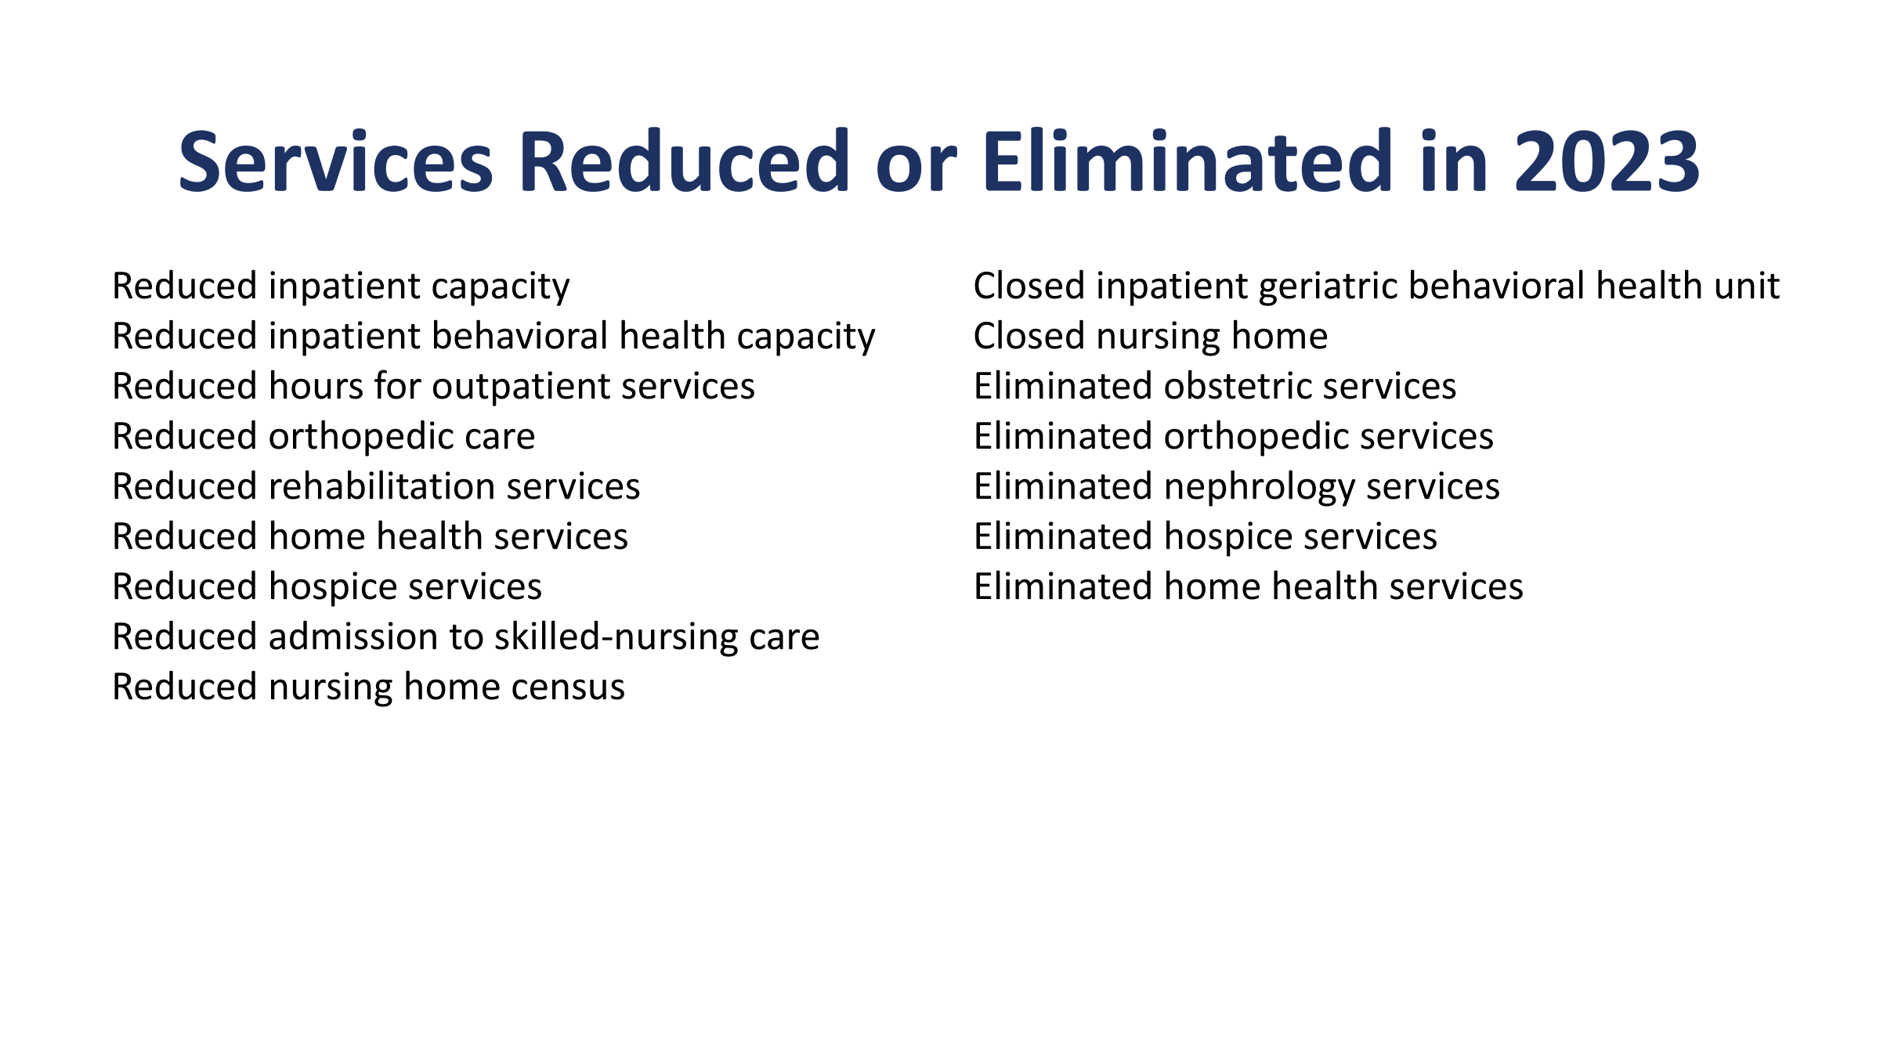

Slide 7
The Wins!
Provider Assessment & Directed Payment program
Medicaid reimbursements are not keeping up with the cost of care.
Nearly $1B in loses from public programs.
43% of Nebraska hospitals ran a negative operating margin in the last quarter.
Establish a partnership with state to pursue maximum allowable federal reimbursement for Medicaid.
44 states have a hospital assessment supporting rates.
68.68% blended FMAP. $1 invested by state or provider assessment is matched about $2.19 by Fed.
CMS authorizes Directed Payments through MCOs up to average commercial rates.
NE has two assessment programs - nursing homes & ICF

Slide 8
$900 million per year!!

Slide 9
The Who: The Nebraska Legislature
Unicameral: 49 Legislative Districts
49 state senators
Approx. 40,000 constituents
Elected to 4-year terms (two terms)
“Citizen Legislature” - Salary of $12,000/year
14 Committees
  Appropriations
  Banking, Commerce, & Insurance
  Health & Human Services
  Revenue

Slide 10
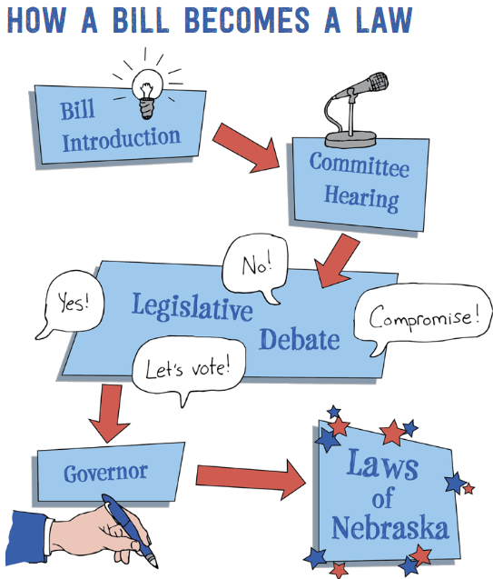

Slide 11
The How
Build Relationships with Legislators and their staff
  Town halls, athletic events, community events, send an email introducing yourself or your ideas, thank you emails!
Communicate Your Hospital’s Needs
  What are your pain points? Any exciting wins? Reach out to your leadership and NHA for help!
  Do we need legislation? Regulatory change? Clarification from DHHS?
Mobilize Grassroots Advocacy
  Ask your coworkers, friends, neighbors to get involved by sending an email or calling their senator
Engage with the NHA
  We track and shape legislation, need your input, can coordinate with lobby efforts

Slide 12
WHAT CAN YOU DO?
Personal Visits and Meetings
Hospital and Community Tours
Understand the Life of a Senator
Phone Calls, Letters, and Emails
Social Media
Get More People Involved
Attend Advocacy Day
Subscribe to Newslink
Attend monthly NHA Member Calls
Contribute to the NHA Political Action Committee

Slide 13
NHA CONTACTS
Meghan Chaffee
Chief Advocacy and Legal Officer
mchaffee@nebraskahospitals.org
402-742-8563
David Slattery
Sr. Director of Advocacy
dslattery@nebraskahospitals.org
402-742-8153
Andy Hale
Chief People and Member Engagement Officer
ahale@nebraskahospitals.org
402-742-8146

Slide 14
Questions?

