Slide 2
TAX CUTS
MEDICAID
ONE BIG BEAUTIFUL BOUT

Slide 4
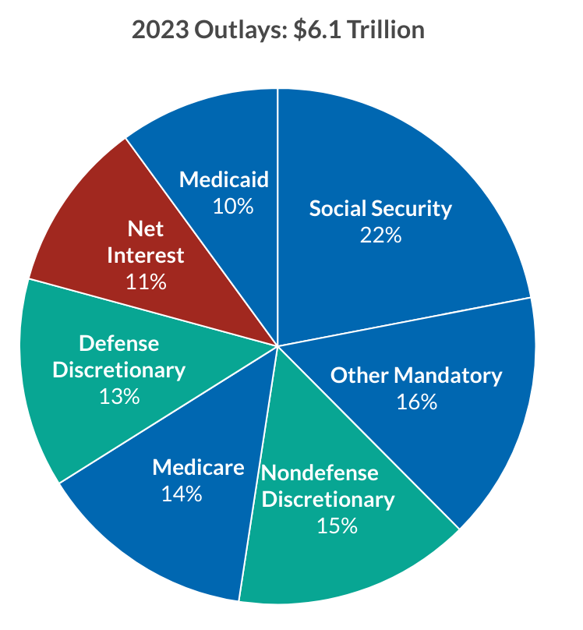
Federal Budget Overview
Budget Reconciliation Process
Reconciliation allows for bill to pass Senate with simple majority
On May 22nd, House passed their package on 215-214 vote
CBO Estimates
$3.7T in revenue reduction
$1.3T in spending cuts
Adds $2.4T to debt/10 yrs.
10.9M lose health coverage

Slide 5
Medicaid Policy Changes - OBBBA
Policy | Estimated Savings | Coverage Loss
Community Engagement (Work Requirements) | $344B / 10 years | 4.8M
Moratorium on Enrollment & Eligibility Rules | $166B / 10 years | 600,000
Limit Use of Provider Taxes Limit State Directed Payments Managed Care Tax Changes | $89.3B / 10 years $72B / 10 years $34.6B / 10 years | 400,000
Increase Eligibility Redeterminations | $64B / 10 years | 700,000
Moratorium on Nursing Home Staffing Rule | $22B / 10 years
Increase Co-Pays for Beneficiaries in Expansion States | $8.2B / 10 years
Reduce 5% FMAP Bonus | $13.6B / 10 years
FMAP Reductions for State Coverage of Undocumented Immigrants | $11B / 10 years | 1.4M
Limit Retroactive Coverage | $6.3B / 10 years
Delay Medicaid DSH Cuts for Three Years | ($16B / 5 years)
*CBO Estimate: More than $800B / 10 years*

Slide 6
Key Issues for the NHA
State Directed Payment
Approval of Medicaid State Directed Payment (SDP) Program.
Grandfathered Approved and Submitted SDPs.
June 6 WH Memo
Other
Eliminate co-pays for Medicaid
Reduce impact of work requirements
Protect retroactive coverage
Next Steps
Senate will unveil proposal soon.
How similar to the House bill?
White House want to pass bill by July 4th.
Federal debt ceiling will hit in August.

Slide 8
Medicaid SDP Implementation Overview
NHA staff continue to prep for disbursement of the initial round of SDP quarterly payments within 60-days of CMS approval
The 8 hospital Claim Payments Work Group has validated underlying Medicaid MCO claims data and validated the accuracy of DHHS calculations
In the short-term, and given recent changes to UBT's on-line banking platform, we will be focused on ensuring the UBT transaction banking structure is tested and ready
In the longer-term, NHA staff will continue to "harden" our internal infrastructure through planned third-party testing and independent review of TPA policies & procedures

Slide 9
Medicaid Quality Overview & Update
3 Key Required Metrics:
SDOH Screening
Post-Partum Depression Screen for Delivering Hospitals
CAUTI
Additional Data:
Metrics broken down by payer or patient type
Supplemental Metrics:
Increase unique Age-Friendly organizations
Explore use of ED for primary diagnoses related to behavioral health
Quarterly scorecards distributed

Slide 10
Medicaid Quality Overview & Update
Quality Performance:
Reporting Compliance:
Q32024 = 100%
Q42024 = 100%
Q12025 = 99%
Goals increased substantially related to performance in initial
quarters.
CAUTI | Num | Den | Q1 Rate 2025 | Q4 Rate 2024 | Q3 Rate 2024 |  | Goal SIR: | 0.7
State Average | 27 | 35,089 | 0.08% | 0.06% | 0.06%
Urban Average | 21 | 25,155 | 0.08% | 0.07% | 0.09%
Rural Average | 3 | 6,510 | 0.05% | 0.03% | 0.00%
CAH Average | 1 | 2,657 | 0.04% | 0.09% | 0.34%
SIR |  |  | 0.5 | 0.4 | 0.4
SDOH | Num | Den | Q1 Rate 2025 | Q4 Rate 2024 | Q3 Rate 2024 |  | Goal: | 70%
State Average | 29,834 | 35,823 | 83.28% | 80.96% | 77.90%
Urban Average | 20,235 | 24,697 | 81.93% | 75.95% | 75.95%
Rural Average | 5,891 | 6,983 | 84.40% | 84.74% | 84.74%
CAH Average | 3,054 | 3,482 | 87.71% | 75.77% | 75.77%
PPD | Num | Den | Q1 Rate 2025 | Q4 Rate 2024 | Q3 Rate 2024 |  | Goal: | 75%
State Average | 6,137 | 6,411 | 95.73% | 95.19% | 91.19%
Urban Average | 4,371 | 4,531 | 96.47% | 97.44% | 95.55%
Rural Average | 1,331 | 1,397 | 95.28% | 90.08% | 84.03%
CAH Average | 435 | 483 | 90.06% | 88.91% | 76.62%

Slide 11
Medicaid Quality Overview & Update
Age-Friendly: Goal by EOY 2025 = 39 Unique Organizations, 3 AF Communities
Emergency Department Behavioral Health Usage Data:
Report Distributed Annually
Data from NHA Data Dimensions Claims Based Data
Level 1 | Level 2 | Communities
22 | 43 Unique Organizations | 2

