Slide 1

Vitality
Payer Scorecard
Holding Payers Accountable
with Provider Data

Slide 2


Nerd vs Geek by Don McMillan
Socially
Awkward
IQ
Dork
Nerd
Geek
Stalker
Obsession

Slide 3
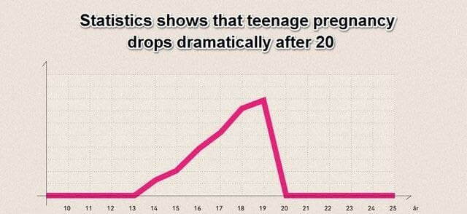
Statistics can be misleading by Don McMillan

Slide 4

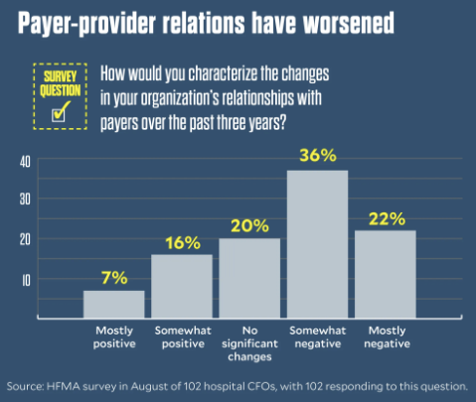
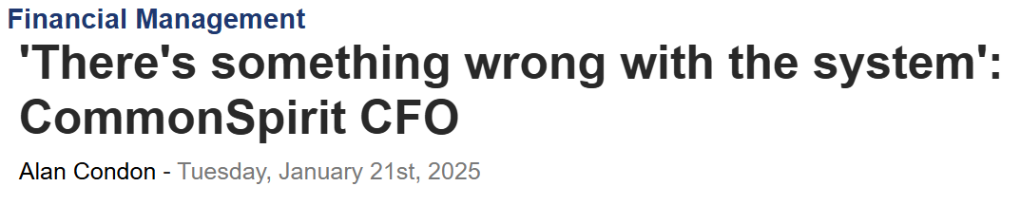
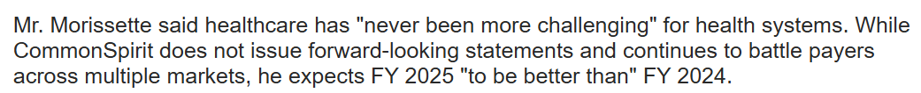
Providers demand for Payer Accountability

Slide 5

Challenges in rural health
Need a collective voice
Rural hospitals need a platform to unite and speak as one against the payers. Feel helpless.
No bandwidth to find problems
Resources are limited and play multiple roles. Need an easy way of identifying problems.
Need technology to help
Rural hospitals often don’t have access to latest technology.
Medicare Dis-Advantage
There is nothing advantageous of MA for Rural. Already struggling.

Slide 6
Payers’ Perspective

Slide 7

“Those puny ants outnumbers us a hundred to one.
And if they figure that out, there goes our way of life.
It is not about food; it’s about keeping those ants in line.”
-Hopper

Slide 8




Slide 9


Slide 10
Providers’ Perspective

Slide 11


Slide 12







Slide 13
Hyve’s Perspective

Slide 14



Slide 15
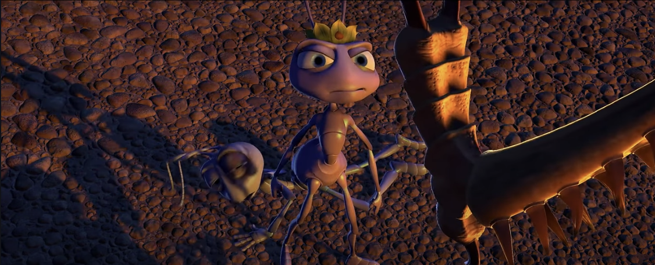

PROVIDERS
PAYER

Slide 16
PROVIDERS
PAYER

Slide 17

Solution: Aggregated, Democratized Data
Create the most CREDIBLE data
Harvest raw 837/835 data from the source.
Hospitals are the source.
Create the most TIMELY data
Timely data is needed to influence change.
6-18 month old data
Create the most SECURE data
PHI from 837/835s is removed at the source.
No BAA needed.
Create the SAFEST data
Hospitals cannot see each other’s data.
Anonymity is crucial

Slide 18



PHI Scrubber and Data Flow
Hospital
File Receiver
(Quarantine)
Hyve Health
837
PHI Scrubber
PHI Scrubber
837
De-identified Matching Encounters
SFTP
835
835
Identified Information
De-Identified Information

Slide 19

What can the Vitality Payer Scorecard tell you?
Discharge to claim (how fast do you drop a claim)
Clean Claims (what percent of my claims are paid first time)?
Prompt Pay (how fast do your clean claims get paid)?
Reimbursement
Downcoding (when are payers changing the level of care)?
Lessor Rate or Charge (when did my charges fall below contract)?
2 Midnight Rule – OBS (Medicare vs MA)
Denials

Slide 20

How can I compare?
Financial Class (Comm, Medicare, MA, Medicaid, Managed Medicaid)
Payer (Aetna, BCBS, UHC, Cigna, Humana, etc)
Specialty (OB, Cardiac, Ortho, etc)
Patient Type (IP, OP, ED, OBS)
IP, Orthopedic, UnitedHealthcare Medicare Advantage
You vs the state
You across states
Not limit to your EHR, Clearinghouse, or other vendors.

Slide 21

Who and Where?
25 state hospitals associations across the country and discussions with 5 more
National partnership with HFMA
National partnership with NRHA
In the last two years, Hyve have contracted with over 900 hospitals.

Slide 22
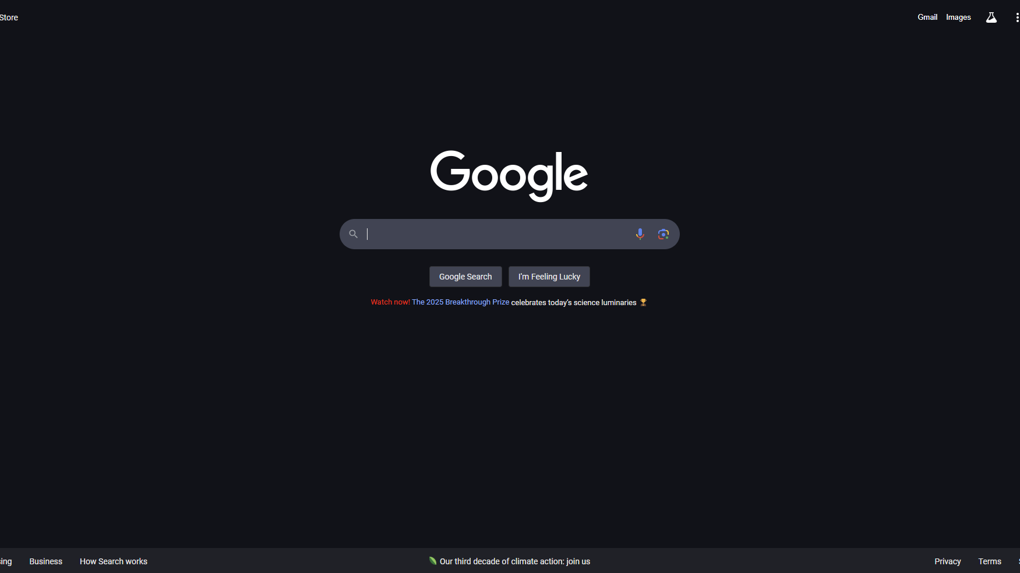
www.payerscorecard.com
Self-paced online training

Slide 23


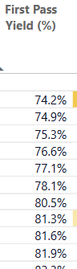






Would you like to know…
Worst
Best

Slide 24
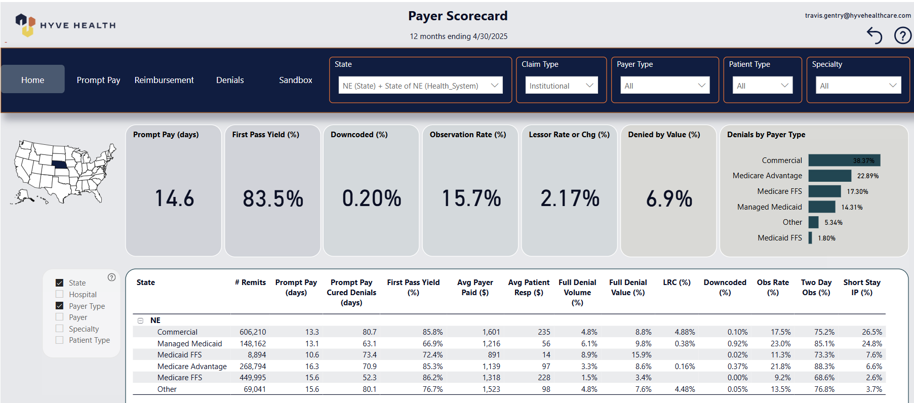
High Denials State Medicaid
State Medicaid

Slide 25
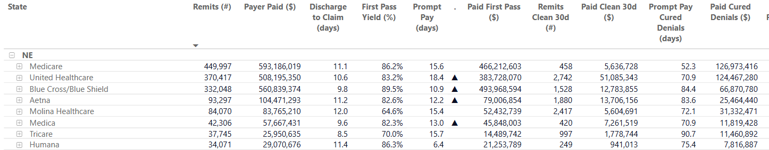
Late Payments = Penalties? Interest?
$51M??

Slide 26
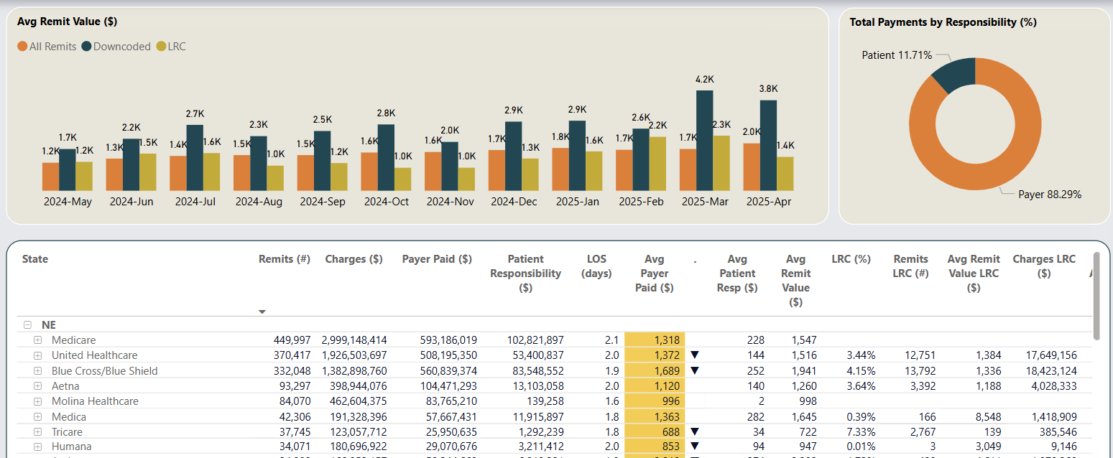
Lessor Rate or Charge (LRC)

Slide 27
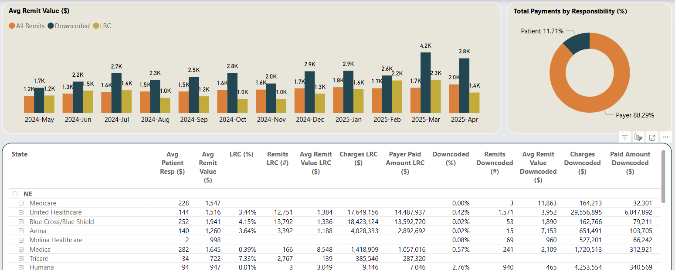
Downcoding

Slide 28
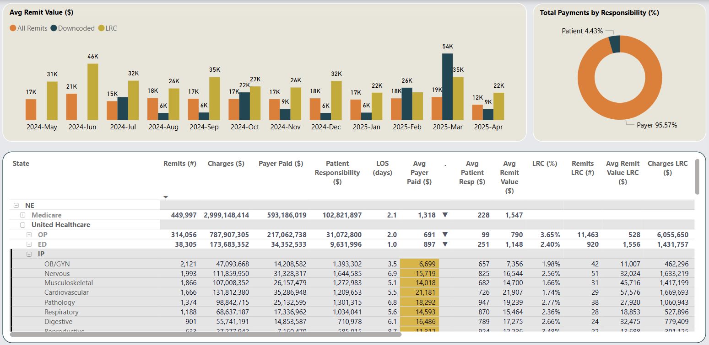
IP United Healthcare LRC

Slide 29
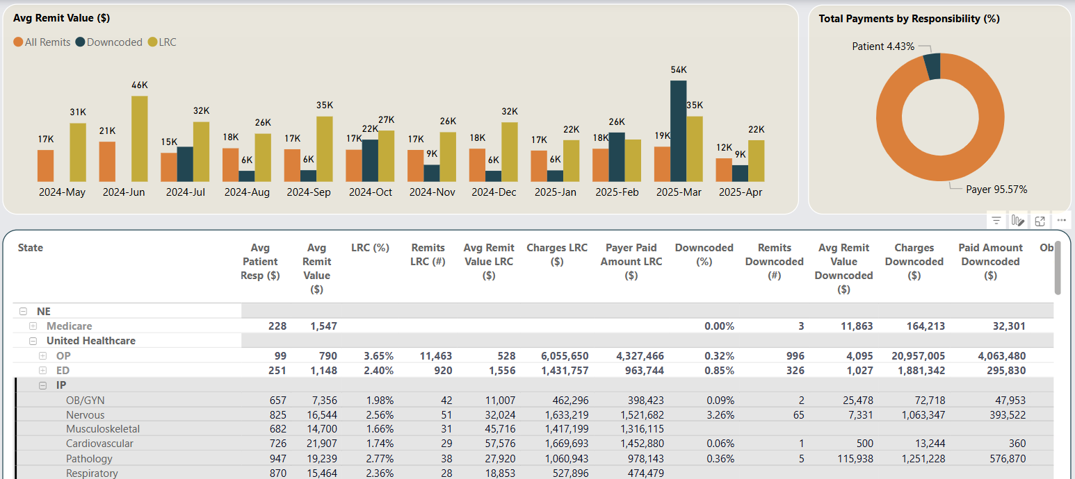
IP United Healthcare Downcoding

Slide 30
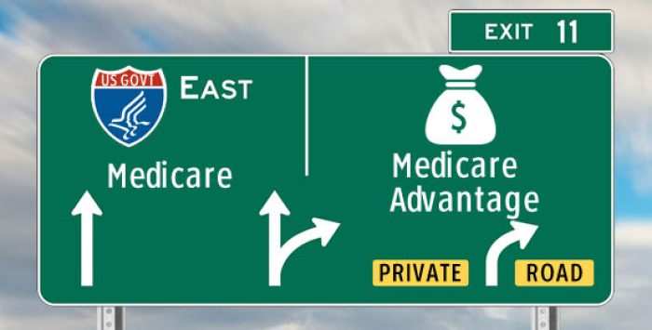
“TAKE”

Slide 31
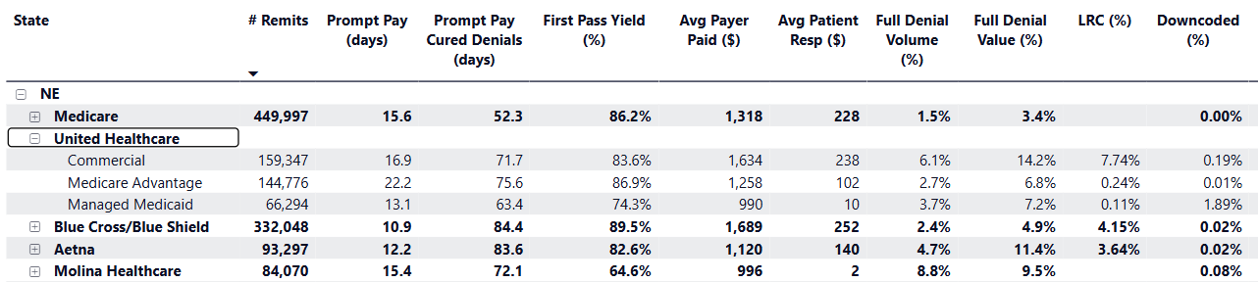
UHC MA pays the slowest in the state
Almost slowest in state
Commercial vs MA Denials???

Slide 32
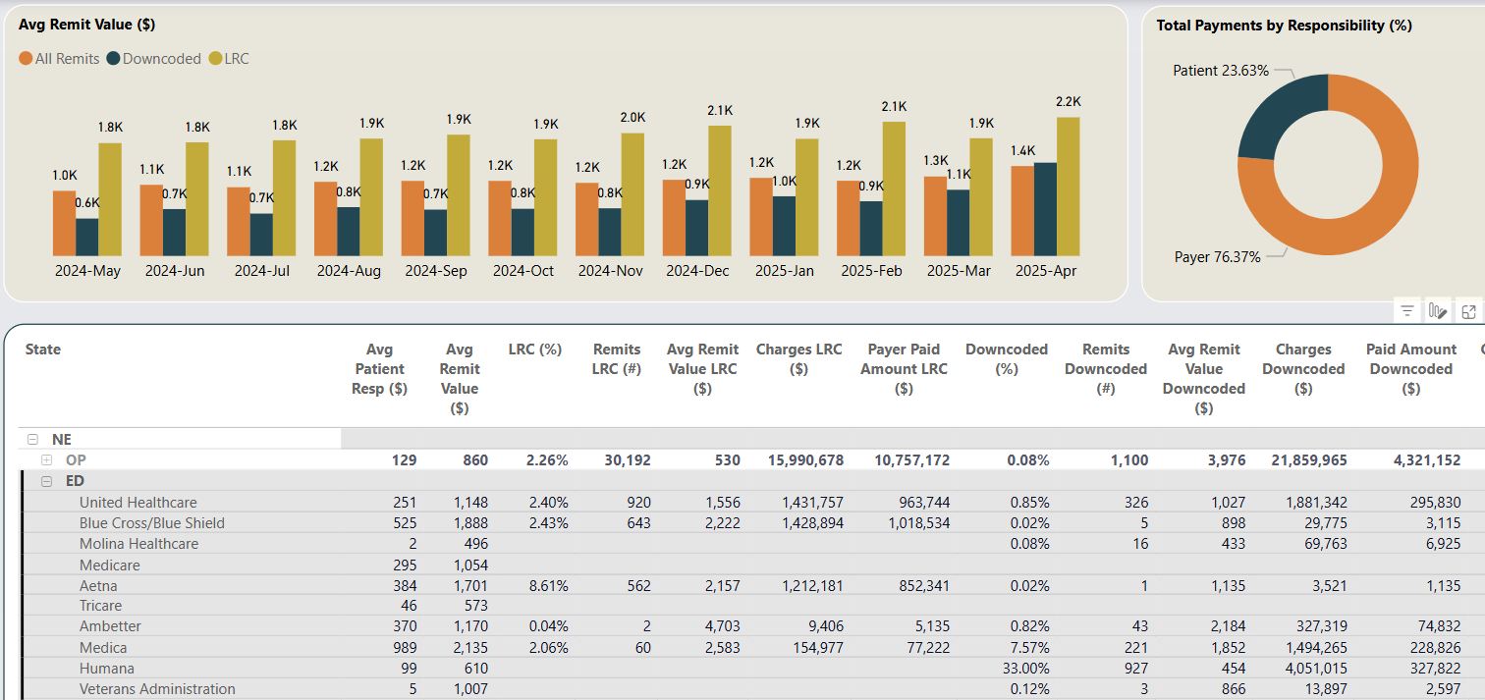
33% of Humana MA ED claims downcoded
What is mine?

Slide 33
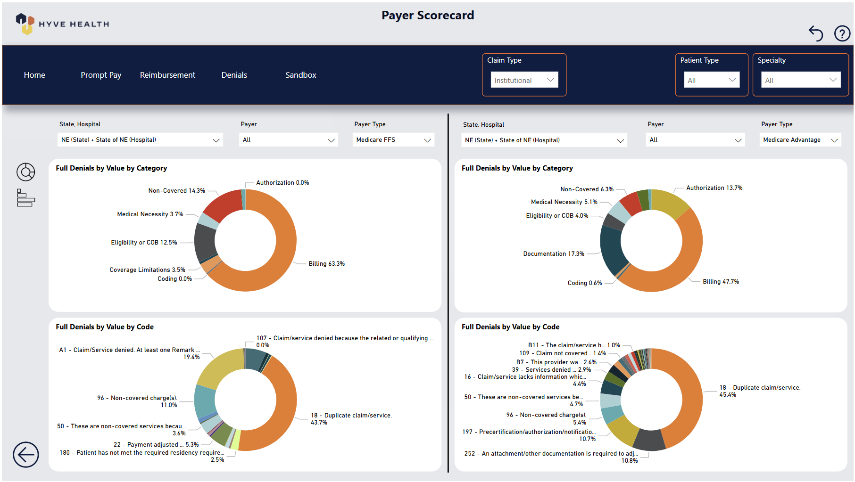
NE has an MA Authorization issue

Slide 34

The time has come for hospitals to unite
Data is the primary difference between why payers are winning and providers are losing.
Providers need normalized, national, and state data to go on the offense against payers.
Peter Drucker: “You can’t manage what do you can’t measure.”

Slide 35

Travis.Gentry@HyveHealthcare.com c: 303.884.6377 www.HyveHealthcare.com www.PayerScorecard.com

