Slide 1

Nebraska Hospital Association
Advocacy Institute
January 8, 2025
Mike Goodman & Carlos Jackson, Principals

Slide 2
What To Expect In 2025

Slide 3
Trump Administration 2.0
Appetite for Disruption…
  Controversial cabinet & leadership nominations – Hegseth, Gabbard, McMahon, RKF Jr, Dr. Oz
  Day one executive orders – Border security/deportations, DEI, gender-affirming care…
  Tariffs on imports – hospital implications
  Roll back certain Biden/Harris regulations (repealed 16 Obama regs in first term)
  Make America Healthy Again
  Medicaid on the chopping block (Project 2025 and Paragon Institute)
  Chip away at Obamacare/ACA, Inflation Reduction Act
  DOGE – Elon Musk & Vivek Ramaswamy
Notes:
Consumer financial protections: Proposed rules banning medical debt on credit reports and restricting data brokers are likely to be abandoned or repealed if passed in Lame Duck period
Nursing home staffing requirements
Climate and energy regulations: Elements of the Inflation Reduction Act promoting renewable energy projects may be scaled back

Slide 4
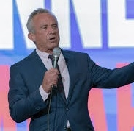

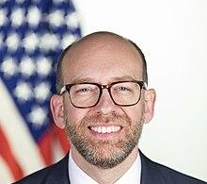
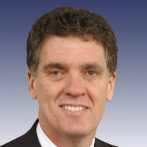


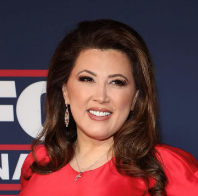
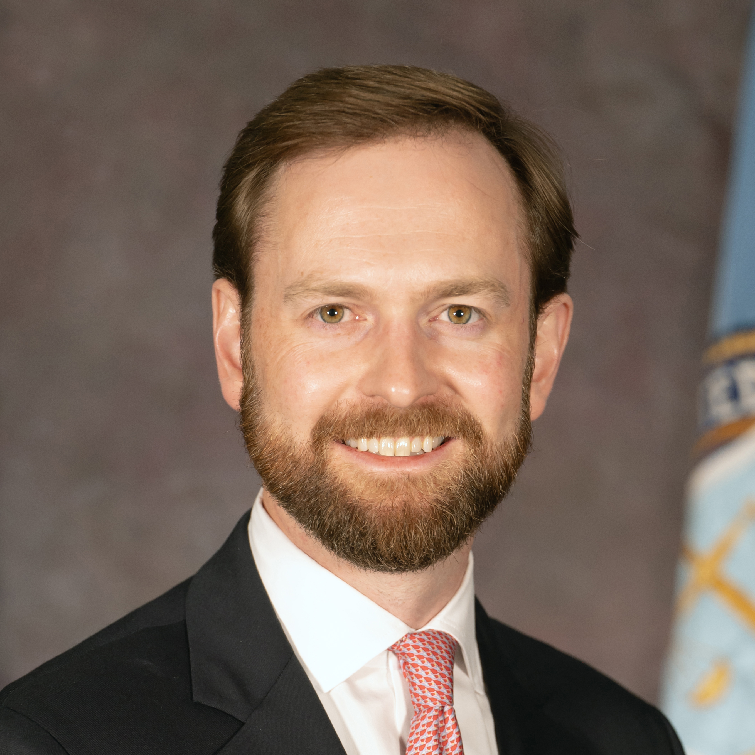


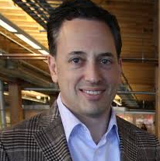
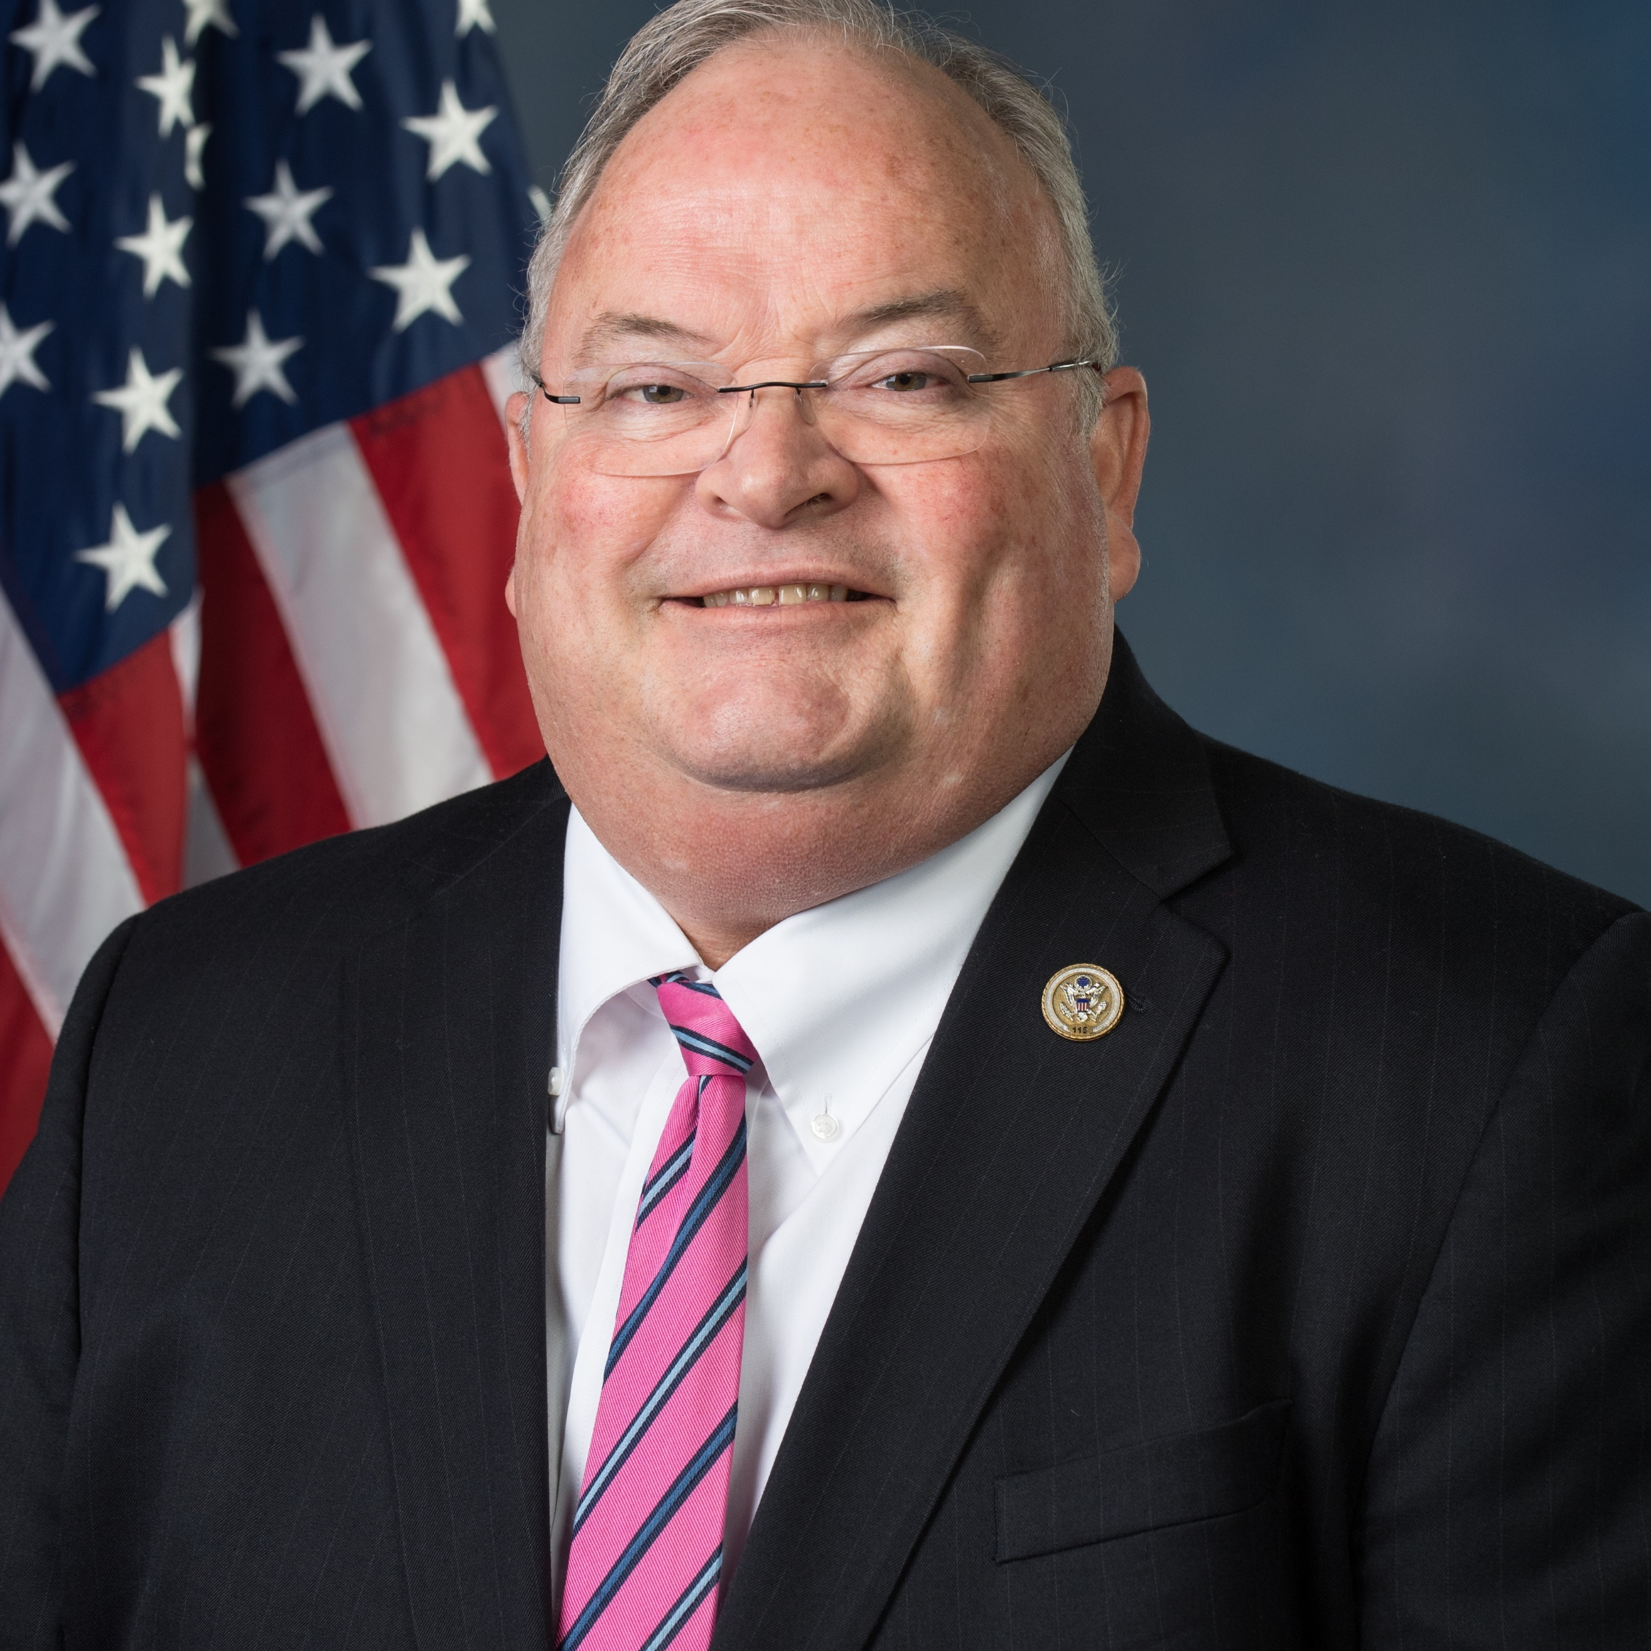
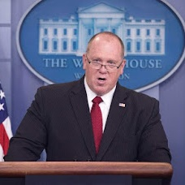
Key Trump Administration Personnel Picks
HHS
RFK Jr.
CMS
Mehmet Oz
OMB
Russell Vought
CDC
Dave Weldon
NIH
Jay Bhattacharya
FDA
Marty Makary
SURGEON GENERAL
Janette Nesheiwat
FTC
Andrew Ferguson
DOGE
Elon Musk
DOGE
Vivek Ramaswamy
AI/CRYPTO CZAR
David Sacks
IRS
Billy Long
BORDER CZAR
Tom Homan
SOURCE Politico.
PRESENTATION CENTER 12/5/24
Notes:
Sources:
Politico Staff, “Who might make up Trump’s Cabinet,” Politico, November 6, 2024, https://www.politico.com/interactives/2024/potential-cabinets/trump-second-term-cabinet/#Labor%20Secretary

Slide 5
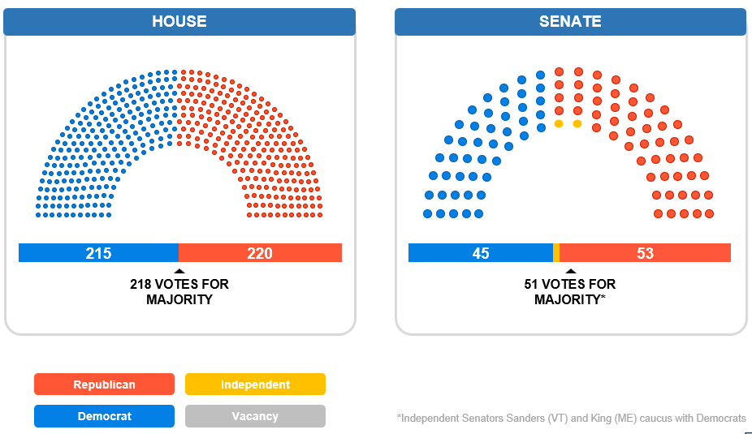
119th Congress

Slide 6

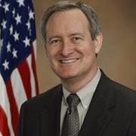
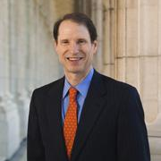

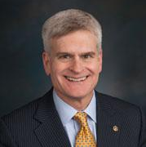
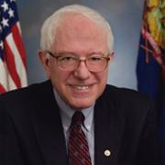

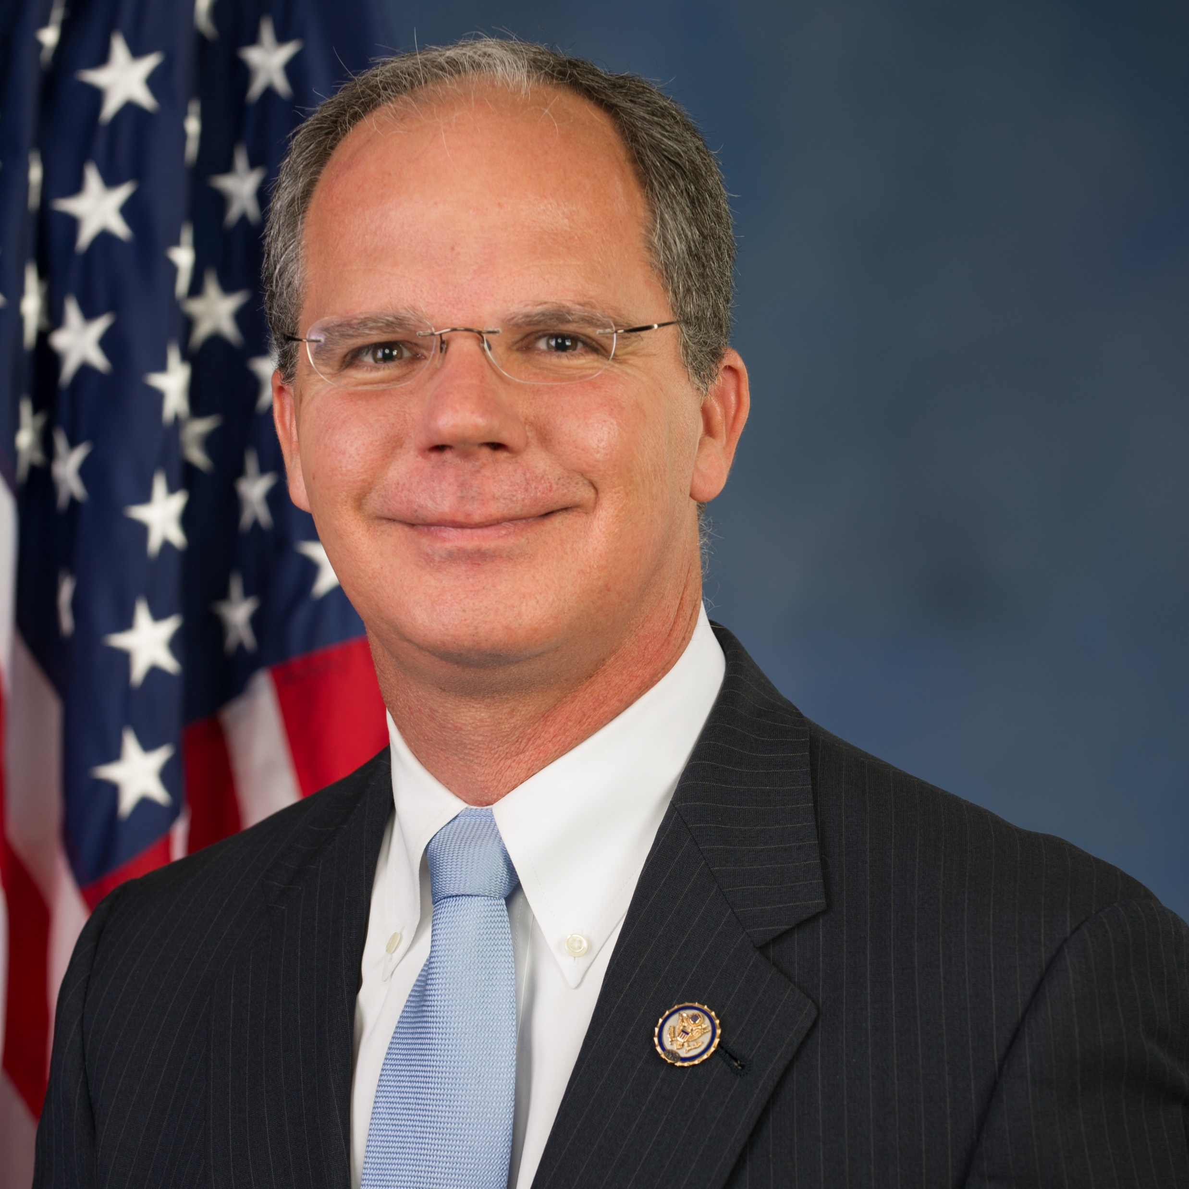
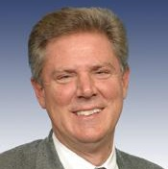

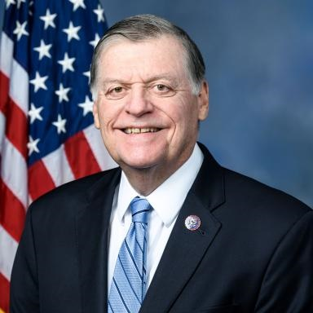
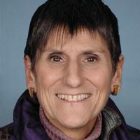
New Committee leaders
COMMITTEE CHAIR
RANKING MEMBER
Finance
Mike Crapo (R-ID)
Ron Wyden (D-OR)
HELP
Bill Cassidy (R-LA)
Bernie Sanders (I-VT)
Energy & Commerce
Brett Guthrie (R-KY-2)
Frank Pallone (D-NJ-6)
Appropriations
Tom Cole (R-OK-4)
Rosa DeLauro (D-CT-3)
SOURCE Senate Democrats, Senator John Thune.
PRESENTATION CENTER 1/7/25
Notes:
Sources:
“Leader Schumer Announces New Senate Democratic Committee Assignments,” Senate Democrats, January 2, 2025, https://www.democrats.senate.gov/newsroom/press-releases/leader-schumer-announces-new-senate-democratic-committee-assignments
“Thune Announces Senate Republican Committee Assignments for the 119th Congress,” US Senator John Thune, December 20, 2024, https://www.thune.senate.gov/public/index.cfm/press-releases?ID=35D445C9-906D-4766-B50E-75E53D511A31

Slide 7
Republican Controlled Congress
Factors to watch…
New Senate Majority leader – John Thune (R-SD)
Budget reconciliation process to pass Trump/GOP legislative priorities
  One bill or two – Trump doesn’t seem to care, he wants the win more than anything
  Extend 2017 tax cuts and finance border security and deportations
  House Freedom Caucus pressure to cut federal spending
    Deficit reduction is not enough, will entitlement and discretionary cuts be on the menu?
    Medicaid cuts (and Medicare provider payment cuts) are on the table
    House Speaker Mike Johnson (LA) on Jan. 7, 2025 – “No one is coming with the intention of cutting benefits in any way”
  DOGE influence
  Enhanced premium tax credits are on the chopping block (Obamacare/Inflation Reduction Act)
Attempts to reform 340B coming at some point

Slide 8
Unfinished Business

Slide 9



Congress Passed Funding Package on Third Attempt
Congressional leaders announce a bipartisan funding agreement
Legislation included a three-month government funding extension, $100 billion in disaster aid, farmer assistance funding, PBM reform measures, and other infrastructure provisions
TUESDAY, DECEMBER 17
Bipartisan bill faces backlash from some GOP lawmakers, Elon Musk, and President-elect Trump
Republican lawmakers and Musk criticized the inclusion of unrelated provisions, calling it a “Christmas tree” bill
Trump asked the GOP to reject the bill, urging a CR without Democratic priorities and tied to a debt limit suspension
WEDNESDAY, DECEMBER 18
Congress fails to pass a new, Trump-backed bill that includes a debt limit suspension
New legislation removed many provisions included in the original agreement, but kept a funding extension, disaster aid, and farm assistance; notably, the bill extended the US borrowing limit until 2027
38 House Republicans joined all but two Democrats to vote against the bill
THURSDAY, DECEMBER 19
Congress passes third government funding proposal
The House ended days of chaos on a 336-34 vote. All but one Democrat voted with 170 Republicans to pass the bill
Senate approves bill by a
FRIDAY, DECEMBER 20
SOURCE CNN, AP News, NBC, Washington Post, The Hill, Fox News, National Journal Daily.
PRESENTATION CENTER 12/23/24
Notes:
Sources:
Katie Lobosco, Tami Luhby, “Here’s what’s in the government funding agreement,” CNN, December 18, 2024, https://www.cnn.com/2024/12/18/politics/government-funding-bill-congress-explainer/index.html
Kevin Freking, “Congress unveils funding deal with more than $100 billion in disaster aid,” AP News, December 17, 2024, https://apnews.com/article/congress-budget-government-shutdown-farmers-disaster-relief-4c6ae1e0033637bb6398b00c4799ba0d
Casey Wooten and Lauren Green, “In chaotic, angry spending battle, 2025 arrives early,” National Journal Daily, December 19, 2024, https://www.nationaljournal.com/s/727116/in-chaotic-angry-spending-battle-2025-arrives-early/
Casey Wooten and Savannah Behrmann, “A CR-istmas miracle: Congress approves spending bill following days of delay and discord,” National Journal Daily, December 20, 2024, https://www.nationaljournal.com/s/727126/a-cr-istmas-miracle-senate-to-vote-on-stopgap-funding-bill-after-house-passage-following-days-of-delay/
Lisa Mascaro and Kevin Freking, “House rejects Trump-backed plan on government shutdown, leaving next steps uncertain,” AP, December 19, 2024, https://apnews.com/article/government-shutdown-trump-musk-johnson-e4b5c93d12838d180740a35daecc118d
Michael Dorgan, “President Biden signs stopgap funding bill into law, narrowly averting shutdown,” Fox News, December 21, 2024, https://www.foxnews.com/politics/president-biden-signs-stopgap-funding-bill-law-narrowly-averting-shutdown
Mychael Schnell and Aris Folley, “House passes bill to avert government shutdown after whirlwind funding fight,” The Hill, December 20, 2024, https://thehill.com/homenews/house/5051634-government-funding-shutdown-house-bill/
Scott Wong et al, “House votes down Republican bill to avert shutdown on eve of the deadline,” NBC News, December 19, 2024, https://www.nbcnews.com/politics/congress/trumps-demands-leave-republicans-no-plan-government-shutdown-rcna184866
Kyle Stewart, “Here's what happens if the government shuts down right before the holidays,” NBC News, December 19, 2024, https://www.nbcnews.com/politics/congress/government-shutdown-deadline-approaches-impact-benefits-what-happens-n-rcna184901
Taylor Telford and Jacob Bogage, “The U.S. government could shut down this weekend. Here’s what to know.,” Washington Post, Updated December 20, 2024, https://www.washingtonpost.com/business/2024/12/19/government-shutdown-deadline-effects-2024/

Slide 10
CR Funds Health Items through April 1, 2025
Health “Extenders”
Community Health Centers
National Health Service Corps
Teaching Health Centers GME
Special Diabetes Programs
Health Security provisions (partial PAHPA)
Medicare & Medicaid Priorities
Medicare
Medicare Dependent Hospital Program
Low-Volume Adjustment
2.93% increase to CY 2024 PFS payments
Work geographic floor index
Ground ambulance add-on payment
Medicaid
Delay Medicaid DSH FY 25 $8B cut
COVID-19 Policy Waivers
Telehealth
Hospital at Home
Notes:
Workforce
Rural Residency Planning and Development Program: $40.5M total through FY 26
Primary Care Training and Enhancement Program: $148.75M total through FY 26
Expanding the Number of Primary Care Doctors: one-time $300M
Nurse Education Practice, Quality, and Retention Program: $1.2B total through FY 28
Nurse Faculty Loan Program: $57M per FY through FY 26
Nurse Faculty Demonstration Program: $15M per FY through FY 25
NURSE Corps Scholarship and Loan Repayment Program $283M total through FY 26
Primary Care Nurse Practitioner Training Programs $30M per FY through FY 26
Allied Health Professionals $100M per FY through FY 26

Slide 11

Bipartisan Provisions Cut From CR
Not Included in Dec. 2024 CR
Medicare Physician Fee Schedule payment increases
Medicare Site-neutral payment
NPI for each HOPD
Extend length of 2% Medicare sequester
Medicaid DSH technical fix
PBM reforms
Full SUPPORT Act and PAHPA reauthorizations
State studies & HHS report on labor, delivery, & maternity costs for rural and urban safety net hospitals
Notes:
Cassidy proposal earlier this year
A few highlights –
Repeals the grandfathered site neutral protections
Includes a 12.5% add-on payment for facilities in the top 10% of high needs hospitals nationwide, rural facilities, and Medicare-dependent facilities
Includes an additional 12% add-on payment for facilities that participate in a downside risk ACO
10/29 Axios
The framework is slated to be more expansive than some previous site-neutral policies and could look similar to what's been proposed in the June 2023 MedPAC report.
MedPAC recommended that for certain services, Medicare payments to hospital outpatient departments, ambulatory surgery centers and freestanding physician offices should be more closely aligned.
That means this policy would apply to a number of outpatient services that could be provided in each type of setting.
The savings from the site-neutral policy could then be reinvested into certain hospitals (budget neutral)

Slide 12



Congress Has Until March 14 to Fund Federal Government
3 WAYS TO AVOID A GOVERNMENT SHUTDOWN
Continuing resolution
Provides budget authority for federal agencies and programs to operate until regular appropriations are enacted
Omnibus bill
Package of appropriations bills passed together, rather than in the traditional separate manner
Cromnibus bill
Combination of long-term omnibus spending bills and short-term continuing resolution for some programs
1
2
3
SOURCE CRS, Committee for a Responsible Federal Budget, District Policy Group, US Senate, CBS News.
PRESENTATION CENTER 12/19/24
Notes:
Sources:
Kaia Hubbard, “Congress passes 3-month funding extension to avoid government shutdown,” CBS News,” September 25, 2024, https://cbsnews.com/news/house-vote-continuing-resolution-government-shutdown/
James Saturno, Bill Heniff, Megan S. Lynch, “The Congressional Appropriations Process: An Introduction,” Congressional Research Service, November 30, 2016, https://www.senate.gov/CRSpubs/8013e37d-4a09-46f0-b1e2-c14915d498a6.pdf.
“Appropriations 101,” Committee for a Responsible Federal Budget, May 30, 3018, https://www.crfb.org/papers/appropriations-101.
James Saturno, Brian Yeh, “Authorization of Appropriations: Procedural and Legal Issues, “ Congressional Research Service, November 30, 2016, https://fas.org/sgp/crs/misc/R42098.pdf.
“Cromnibus,” The District Policy Group, accessed May 31, 2019, http://www.districtpolicygroup.com/dewonkify-detail/cromnibus.
“Continuing Resolution/Continuing Appropriations,” United States Senate, accessed May 31, 2019, https://www.senate.gov/reference/glossary_term/continuing_resolution.htm.
Kathryn Watson, “President Biden signs short-term funding bill to keep the government open ahead of deadline,” CBS News, November 17, 2023, https://www.cbsnews.com/news/biden-signs-short-term-funding-bill-averting-government-shutdown/
Richard Cowan, Makini Brice “US Congress Passes Bill to Advert Government Shutdown, Sends it to Biden,” Reuters, January 19, 2024, https://www.reuters.com/world/us/us-congress-scrambles-pass-stopgap-bill-avert-government-shutdown-2024-01-18/
“Appropriations Watch: FY 2024,” CFRB, March 1, 2024, https://www.crfb.org/blogs/appropriations-watch-fy-2024

Slide 13
Health Care Implications Outside of the Continuing Resolution: Budget Reconciliation and Additional Threats

Slide 14
Provider Threats: Site-Neutral
Significant budgetary impact
“Good politics”
Trump could leverage regulatory process
  Recall 2018 CMS rule upheld by courts
Impact on rural providers and communities is a concern
  Could Cassidy-Hassan proposal be a solution?

Slide 15
Provider Threats: 340B
Republican House, Senate, and White House = Ideal scenario for drug manufacturers
Trump administrative action
  Recall 2017 Medicare Part B cuts overturned by SCOTUS
    Could be included in a budget reconciliation bill
Reforms on the table
  Contract pharmacies
  Patient definition
  Eligibility criteria
  Child sites
  Transparency reporting
  State legislative actions

Slide 16
Provider Threats: Medicaid Directed Payment Program
CMS approved 302 DPs during Feb. 2023-Aug. 2024
$110B federal spending/year = 60% increase over prior year
Largest DPs target hospitals
2024 CMS managed care rule:
  Formalized avg. commercial rate ceiling
Targeted by Paragon Institute and congressional GOP staff
Potential vehicles
  Trump could leverage regulatory process - Recall Medicaid Fiscal Accountability Regulation (MFAR) from 2019
  Budget reconciliation process

Slide 17
CBO Deficit Reduction Options Dec. 2024
Medicaid
Proposed Policy Change | Federal Spending Reduction (over 10 years)
Lower provider tax/assessment threshold (current federal law allows maximum threshold of 6%) | 5% = $48 billion 2.5% = $241 billion Eliminate = $612 billion
Establish caps on Federal Medicaid Spending (for all eligibility categories) | $459-$742 billion – caps on overall spending $588-$893 billion – caps on spending per enrollee
Reduce Federal Medicaid Matching Rates | $69 billion – same matching rate $530 billion – remove FMAP floor $561 billion – Reduce ACA expansion population

Slide 18
CBO Deficit Reduction Options Dec. 2024
Medicare
Proposed Policy | Federal Spending Reduction (over 10 years)
Reduce payments to hospital outpatient departments (site-neutral) | All off-campus & on-campus = $156.9 billion Drug administration services = $5.6 billion Imaging services all off-campus = $7.6 billion
Reduce payments for drugs delivered by 340B hospitals | ASP-22.5% = $73.5 billion ASP = $15.4 billion
Reduce federal benchmark payments to MA plans by 10% | $489 billion
Modify payments to MA Plans for health risk | $124 billion - $1 trillion***
Reduce Medicare coverage of allowable bad debt | 45% = $16.7 billion 25% = $33.2 billion Eliminate = $54.1 billion
Consolidate Medicare DGME & IME payments for teaching hospitals | CPU growth rate = $94 billion CPU-1% growth rate = $103 billion
Notes:
MA risk payments – current law applies 5.9% reduction
8% = $159 billion
20% = $1 trillion
Use 2 years of diagnostic data to calculate risk scores AND remove diagnoses from health risk assessments = $124 billion
Medicare Bad debt
current federal law reimburses 65% of allowable bad debt

Slide 19
Provider Threats: Tariff Increases
Trump will raise tariffs
  Likely through executive action, but universal hikes are unlikely on day one
  Trump could gradually increase tariffs over several months
    10% global tariff across all imports
    Additional 65% tariff on imports from China
    Additional 25% tariff on imports from Canada and Mexico
Economic and policy considerations will dictate Trump’s actions
  Tariff hikes could lead to price increases and supply chain issues
  Wall street doesn’t appear to be concerned – view tariff threats as tool for diplomatic leverage, not economic disruption
  Cabinet secretaries hold differing approaches
    Treasury Secretary nominee Scott Bessent favors layered, gradual moves
    Commerce Secretary nominee Howard Lutnick wants to “tariff the heck out of the world and keep them out”

Slide 20
Provider Threats: Border/Immigration
Trump will increase deportations – could significantly impact health care workforce
Trump Administration could consider restricting H1-B visas
  Tried to limit H1-B visas during first term
  SCOTUS Chevron ruling could hamper Administration’s ability to implement major policy changes
  Pressure from tech and business community could slow Administration’s ambitions
Administration could attempt to end birthright citizenship via Executive Order
  14th Amendment to Constitution – grants citizenship to “all persons born or naturalized” in U.S.

Slide 21
Provider Implications: RFK, Jr.
Make America Healthy Again
  Opposes vaccines and vaccine mandates, supports vaccine choice
  Favors overhauling federal public health agencies, including NIH, CDA, and FDA
  Calls for immediate end to fluoridation in U.S. drinking water
  Emphasis on reducing chronic disease and prevention
  Supports limiting/banning ultra-processed foods
  Unknown: will MAHA be incorporated into possible Medicaid reforms?

Slide 22
Thank you for your time.
Questions?
Notes:
At least 15 min for Q&A

