Slide 1

National Political Dynamics & its Impact on Health Policy
Jeremy Nordquist
President
Nebraska Hospital Association
jnordquist@NebraskaHospitals.org

Slide 2
Overview
The President
Formal Powers
Informal Powers
Congress
Congressional Framework
House & Senate Committees and Floor Rules
Institutional Differences
What does Congress do?
How is Congress changing?
What Does This Mean for Nebraska Hospitals?
2024 Election & Looking Ahead to 2025

Slide 3
What is government?
“Government is simply a word for the things we decide to do together.”

Slide 4
The President

Slide 5
Formal Powers
Article II, Section I
The executive Power shall be vested in a President of the United States of America.
Executive Powers
“Faithfully executes” laws, treaties, and court decisions
Appoints and removes officials
Assumes emergency powers
Presides over the cabinet and executive branch agencies
Legislative Powers
Gives State of the Union address
Issues annual budget and economic reports
Signs or vetoes bills
Proposes legislation and uses influence to get it passed
Calls for special sessions of Congress

Slide 6
Formal Powers
Diplomatic/Military Powers
Appoints ambassadors and other diplomats
Negotiates treaties and executive agreements
Meets with foreign leaders and receives foreign dignitaries
Recognizes foreign governments
Commander-in-chief of the armed forces
Final decision-making authority in matters of national & foreign defense
Provides for domestic order
Judicial Powers
Appoints members of the federal judiciary
Grants reprieves, pardons, and amnesty

Slide 7
Informal Powers
Executive Powers
Executive Orders: Orders issued by the President that carry the force of law
Executive Privilege: Belief that the President can withhold certain information from the public, including courts and Congress if it serves the national interest
Legislative Powers
Bargaining
Being strategic during the “honeymoon period” – first 100 days
Presidents may set priorities to influence Congress’ agenda
President is nation’s key agenda builder
Political Party Leader
Heavily influences party policies and platform
Chooses vice presidential nominee
Strengthens the party by helping members get elected (coattails)
Appoints party members to government positions
Public Opinion & the Bully Pulpit

Slide 8
Congress

Slide 9
Congressional Framework
Article I, Section I
All legislative Powers herein granted shall be vested in a Congress of the United States, which shall consist of a Senate and House of Representatives.
Why?
Modeled after colonies
Constitutional compromise - to balance the interests of small and large states
Each state has an equal voice in the Senate
  2 per state – 100 members
The House is based on the size of each state’s population
  435 voting members (Average 761,000, 547,000 in RI)
  53 in CA. 1 in AK, DE, ND, SD, VT, WY
  6 nonvoting members in DC, Puerto Rico, American Samoa, Guam, Mariana Islands, Virgin Islands

Slide 10
Congressional Framework
Article I, Section 2 – House of Representatives
  Elections every two years – Two-year terms
  Districts by population – reapportionment every ten years
  Elected by the people
  Special elections to fill vacancies
  Sole power of Impeachment – formal accusation of wrongdoing by a government official; not removal

Slide 11
Congressional Framework
Article I, Section 3 – Senate
  Two Senators from each state
  Six-year terms – Staggered Senate classes
  Elected by the people now
    Prior to the 17th Amendment, Senators were elected by the State Legislatures
  Governor’s can make temporary appointments to fill vacancies until the next election if the legislature allows
  Vice President shall be President of the Senate, but shall have no vote, unless they be equally divided
  Senate shall have the sole power to try all Impeachments

Slide 12
Congressional Framework
Article I, Section 4 – Elections/Convening
  States run elections
  Congress must meet once a year
Article I, Section 5 – Proceedings
  Each chamber judges election returns and qualifications
  Each chamber sets its own rules
  Must have a quorum (one more than half) to meet
  Can punish and expel a member with 2/3 vote
  Congressional Record is a record of all comments and votes made
Article I, Section 6 – Member Rights
  Senators and Representatives get paid – $174,400 since 2009
  Immunity—Members cannot be arrested during or coming or going to a congressional session except treason, felony, or breach of the peace
  Members cannot have any other job for the federal government

Slide 13
Congressional Framework
Article I, Section 7 – Bill Process
  All bills for raising money must begin in the House – Senate can amend
  Bills must pass both House and Senate and must be the exact same language
    Conference Committee (3 Conference Reports in last Congress)
    Ping-pong
    Four corners
  These bills are then sent to the President – If the President signs the bill, it becomes law
  If the President refuses to sign:
    Veto – President sends objections to the bill in writing
    If he does nothing for 10 days, the bill automatically becomes law
    Pocket Veto - If there are less than 10 days left in a session, the President can leave it unsigned and the bill is vetoed
  Congress can override the President veto with 2/3 vote in each chamber
    President Biden vetoed 12 bills – none were overridden
    President Trump vetoed 10 bills – one successful override on National Defense Authorization Act after 2020 election

Slide 14
Congressional Framework
Article I, Section 9 – Enumerated Powers
  Taxing/Spending Power – Collect taxes/duties, pay debts provide for general welfare
  Borrowing Power – Borrow money on credit of U.S.
  Commerce Powers – Regulate Commerce with foreign Nations, among the states, and with the Indian Tribes
  Power to Declare War
  Power to raise an Army and Navy
  Call forth the Militia (National Guard), “suppress Insurrection”
  Naturalization Power – Set rules for immigration and citizenship
  Establish federal courts below the Supreme Court
  Govern D.C. and acquire state land for national purpose
  Coinage, Counterfeiting, Postal, Copyrights & Patents, Bankruptcy
  Necessary and Proper Clause – Congressional power encompasses all implied and incidental powers that are conducive to the beneficial exercise of an enumerated power

Slide 15
Congressional Framework
Article I, Section 9 – Powers Denied to Congress
  Congress could not outlaw or restrict the slave trade until 1808
  Congress cannot suspend Habeas Corpus – Allowing a prisoner to challenge his or her imprisonment in court
  No bills of attainder— A law written to punish someone without that person getting a normal court proceeding
  No ex post facto—“after the fact”
  Could only tax on population prior to 16th Amendment
  Congress cannot tax state exports
  No money can be spent by the government unless Congress appropriates it
  No titles of nobility will be granted to anyone nor can anyone in office in the U.S. accept gifts from a foreigner without the consent of Congress (Emoluments Clause)

Slide 16
Congressional Framework
Article I, Section 10 – Powers Denied to States
  States cannot enter into agreements or treaties with foreign countries
  States cannot coin money nor grant titles of nobility
  States cannot tax imports and exports
  States cannot keep armies in times of peace and cannot engage in war unless invaded or in imminent danger

Slide 17
House & Senate Committees
17,498 bills/resolutions introduced in 116th Congress (2023-2024)
106 became law
House Senate
  Agriculture Agriculture, Nutrition, and Forestry
  Appropriations Appropriations
  Armed Services Armed Services
  Budget Budget
  Education and Labor Health, Education, Labor, and Pension
  Energy and Commerce Commerce, Science, and Transportation
  Financial Services Banking, Housing, and Urban Affairs
  Foreign Affairs Foreign Relations
  Homeland Security Homeland Security and Governmental Affairs
  House Administration
  Judiciary Judiciary
  Natural Resources Energy and Natural Resources
  Rules Rules and Administration
  Science, Space, and Tech
  Small Business Small Business and Entrepreneurship
  Transportation and Infrastructure Environment and Public Works
  Veterans’ Affairs Veterans’ Affairs
  Ways and Means Finance
  Select Committee on Intelligence Select Committee on Intelligence
  Indian Affairs

Slide 18
Floor Rules of House & Senate
House
Majority rule
House Rules Committee sets time limits for debate and the amendments that will be debated
Little debate (1-2 hours per major bill)
Very little ability for minority to stop bills
Senate
Unanimous consent to bring up a bill or a vote
Filibuster - Any individual member or group of member can object
Unlimited debate and no limit on amendments
Cloture – 3/5 vote (60 votes) to stop a filibuster and proceed to a vote
  Confirmations (except Supreme Court) move to 50 votes in 2013
  Supreme Court confirmations move to 50 votes in 2017
This can be changed by ruling of the chair for new precedent

Slide 19
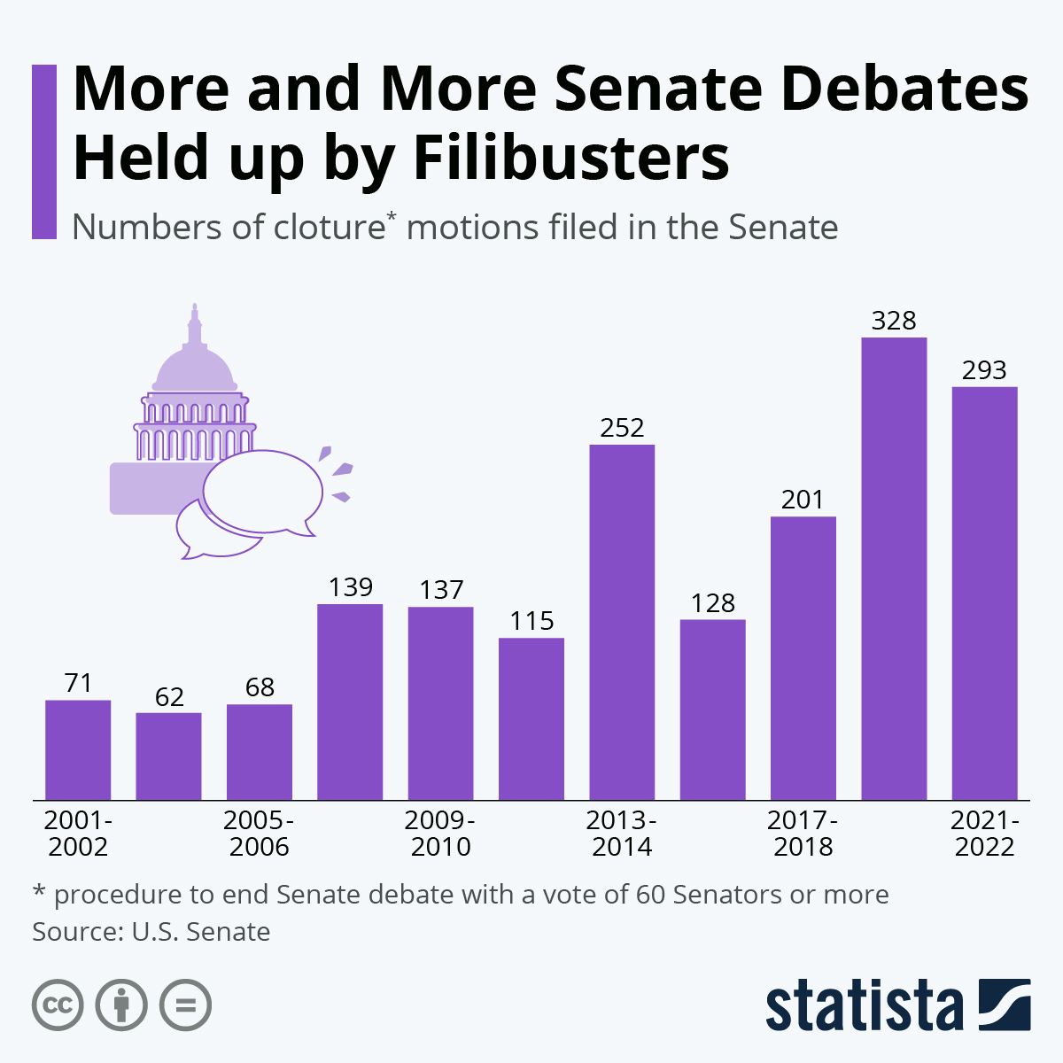
Floor Rules of House & Senate

Slide 20
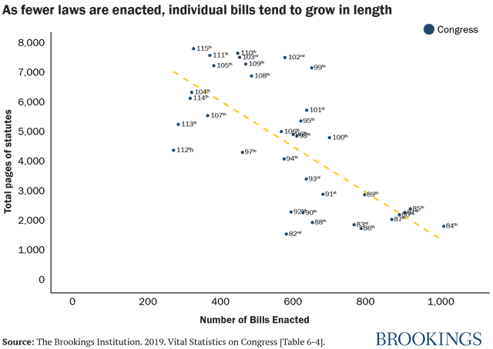
Less Bills, More Complex

Slide 21
Budget Reconciliation
Bills under reconciliation are not subject to the filibuster in the Senate.
House and Senate must pass budget resolution and provide instructions to Committees.
Can address spending, revenue, and debt limit
Senate can pass one bill per year on each of these three areas
“Byrd Rule” limits issues that do not impact budget
Recent use of reconciliation:
2001 Bush Tax Cuts
ACA/Obamacare “clean-up” bill in 2010
American Health Care Act of 2017 (GOP Obamacare repeal - failed by one vote)
2017 Trump Tax Cuts

Slide 22
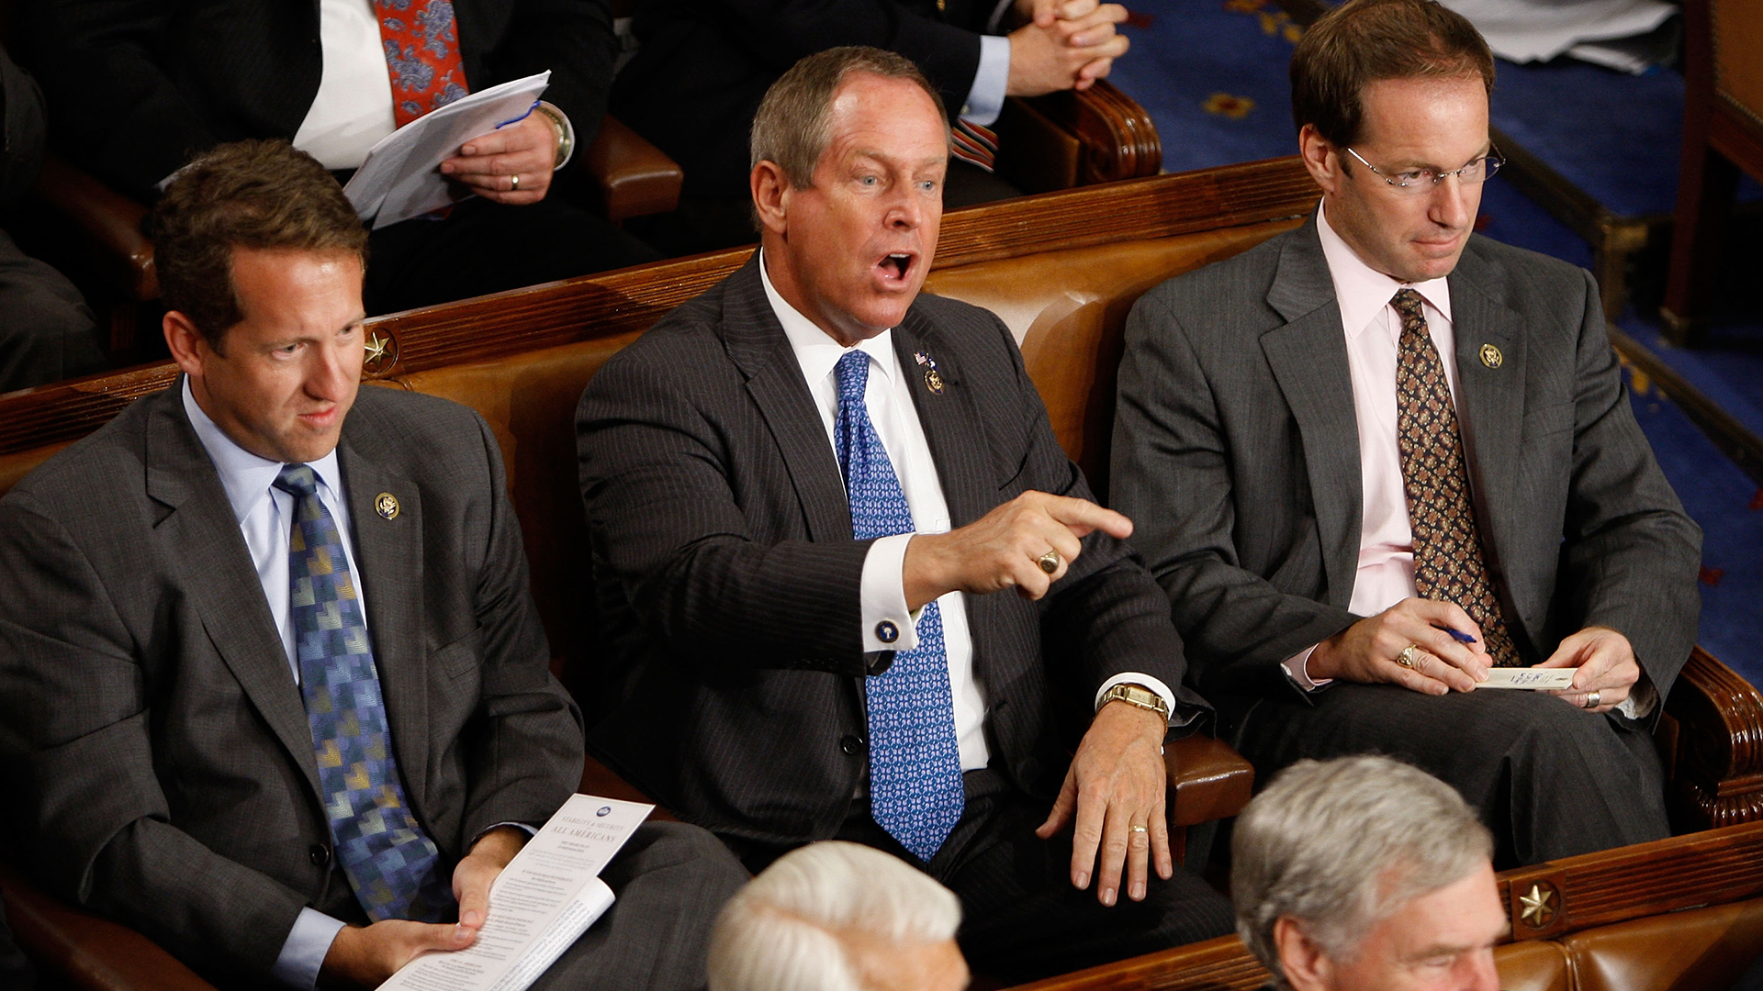
Institutional Differences
House
Lower chamber
Reactive
Bubbling with public sentiment
"Trailer Park”
Senate
Upper chamber
Deliberate
Saucer to cool House actions/public sentiment
"Country Club”

Slide 23
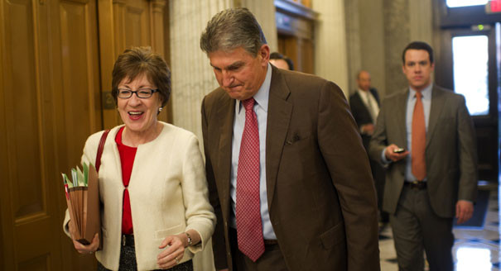






Institutional Differences
Senate
Individual members have power to stop the process and hold items up
House
Less individual power
Work through Caucuses – Issue & Ideological

Slide 24
Congressional Offices
Primary Roles/Functions
Legislative Staff (D.C.)
Constituent Services (District/State)
Outreach (District/State)
Communications (D.C. & District/State)
Office Administration
Senate
$3.4 million to $5.4 million
20 to 60 staffers
Paid internships
House
$1.3 million to $1.9 million
No more than 18 staffers
Paid internships

Slide 25
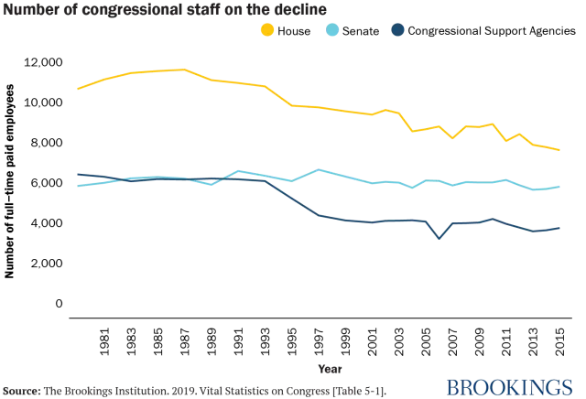
Less Staff

Slide 26
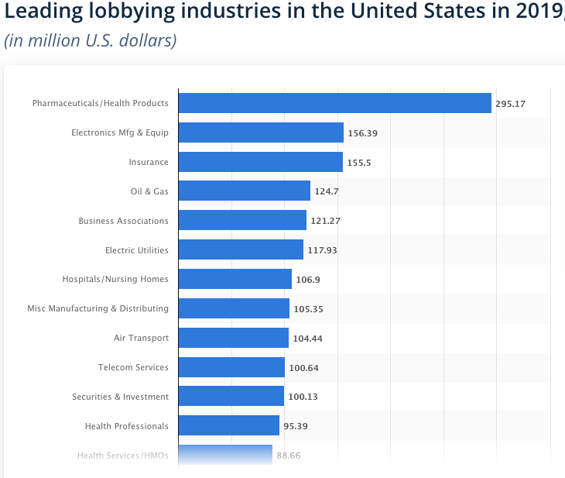
Lobbyists
Lobbyists are professional advocates that work to influence political decisions on behalf of individuals and organizations
Ethics law prohibiting paying for vote
12,937 registered lobbyists in 2023 (24 per member)
1,834 registered for pharmaceutical and health products (4 per member)
813 registered for insurance companies

Slide 27
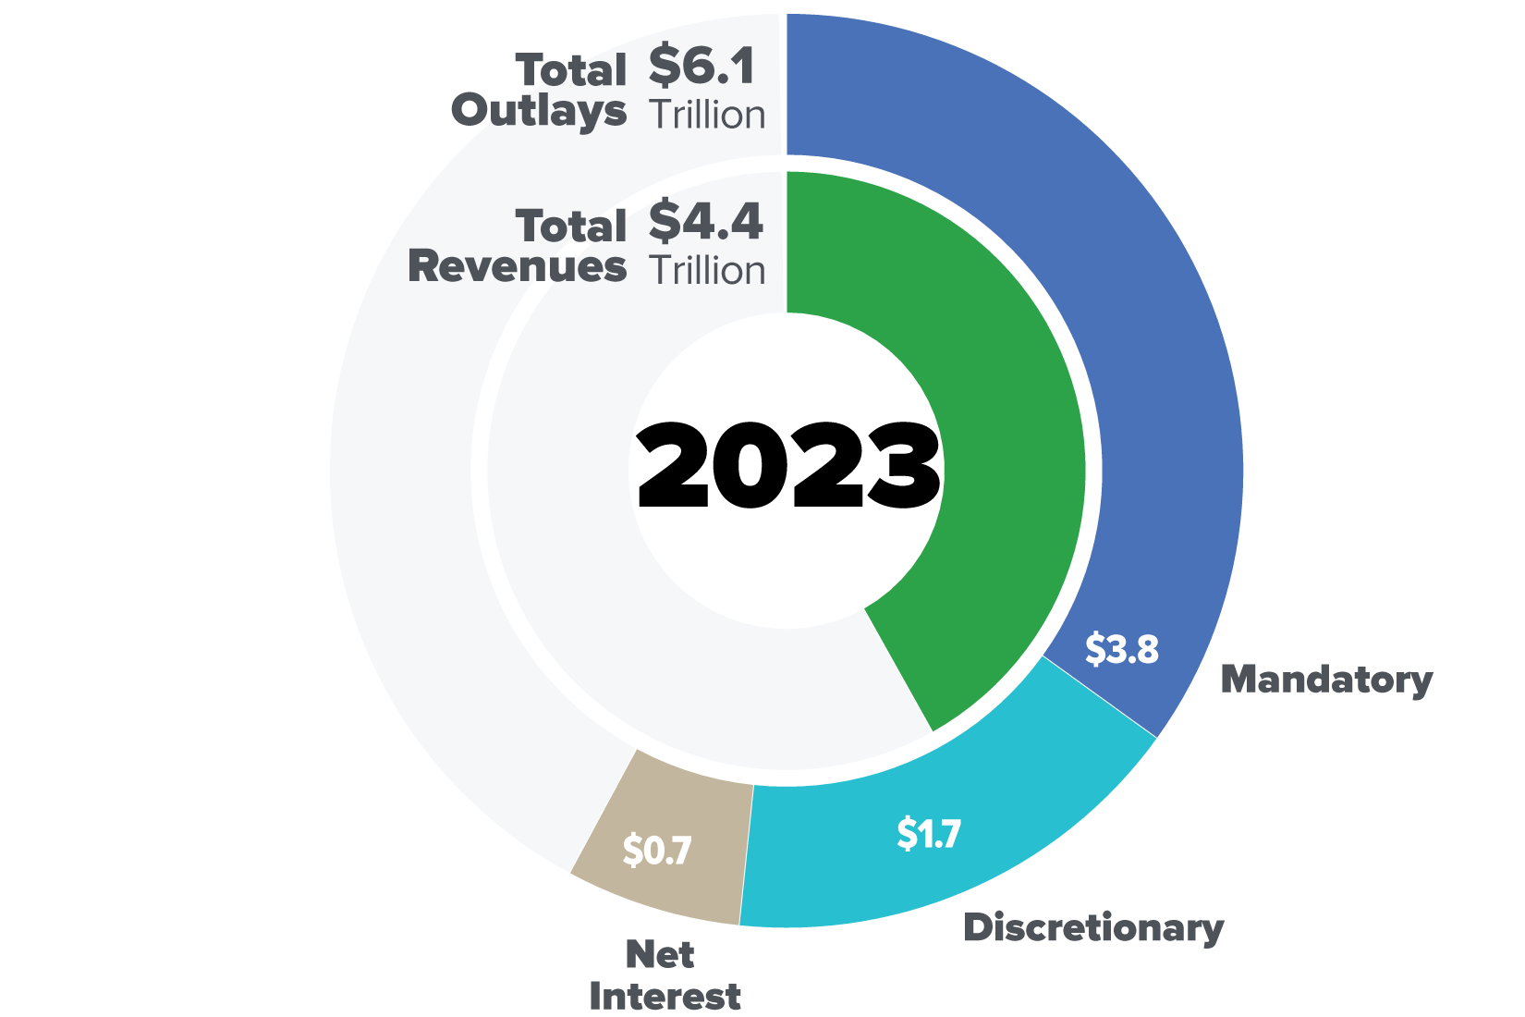
What Does Congress Do?

Slide 28
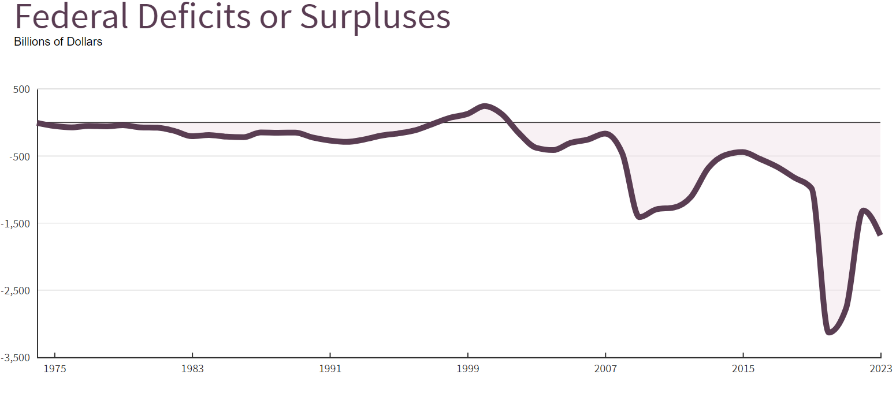
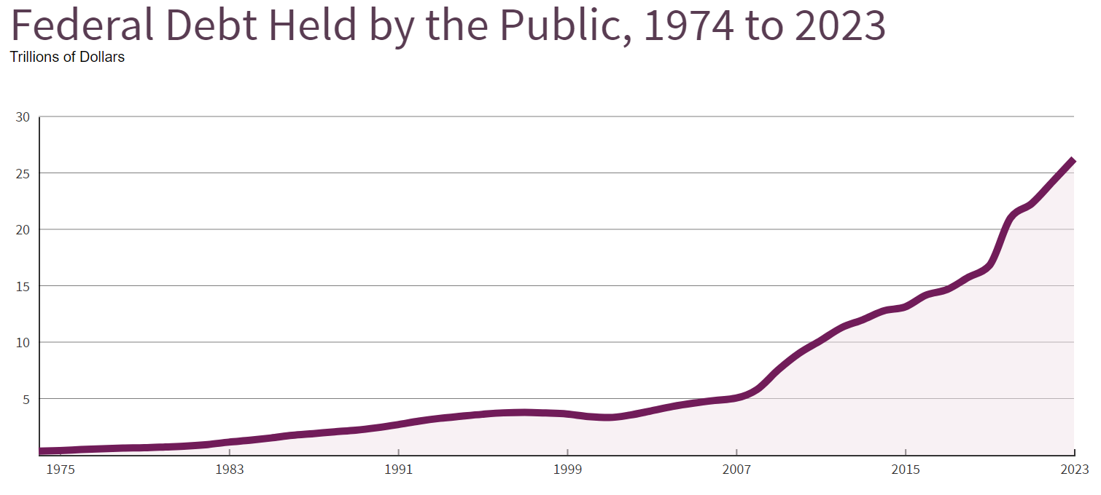
What Does Congress Do?

Slide 29
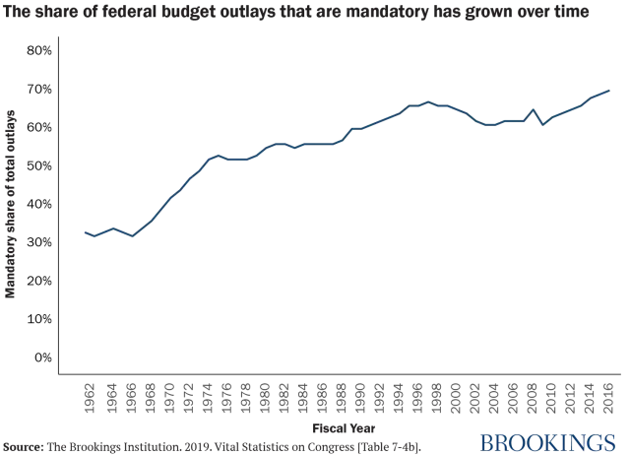
What Does Congress Do?

Slide 30
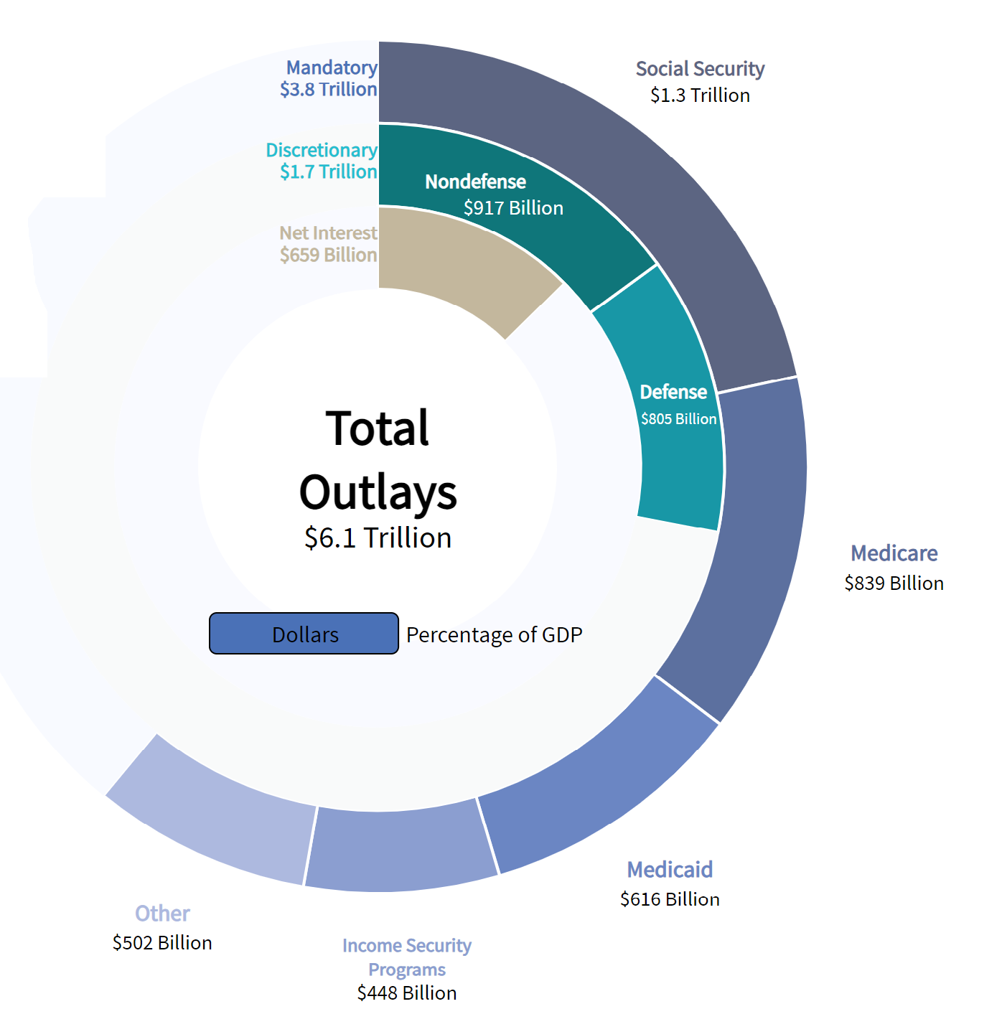
What Does Congress Do?

Slide 31
What Does Congress Do?
Annual Appropriations
Fiscal year Oct 1 to Sept 30th
Shut down of discretionary programs if not appropriated
Process starts with President’s budget request
12 Appropriations bills for discretionary programs
  $805B Defense
  $917B Non-Defense
    Some Veterans Benefits
    Transportation - Highways, aviation, TSA
    Health - Research, CDC, FDA, Community Health Centers
    Education programs - K-12 Disability Support, Head Start, Pell Grants
    Law Enforcement - FBI, Border Patrol
Continuing resolutions
Omnibus, mini-bus, CRomnibus
Pay-Go, Sequestration
Earmarks have come back

Slide 32
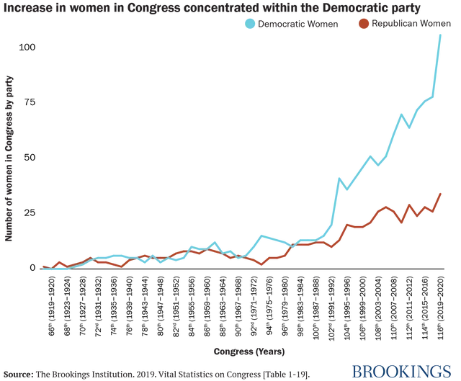
How is Congress Changing?

Slide 33
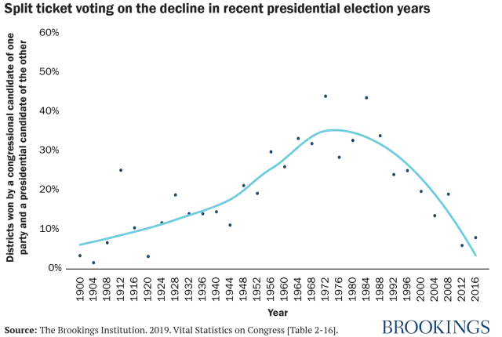
Less Competitive Districts

Slide 34
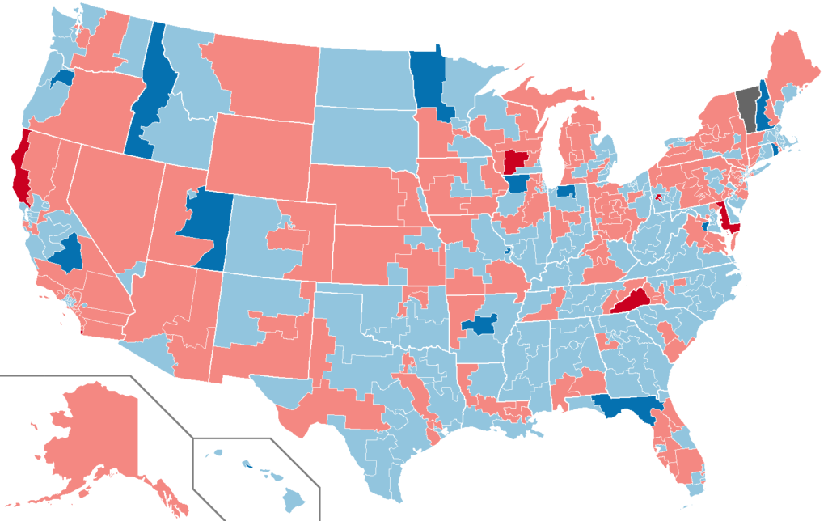
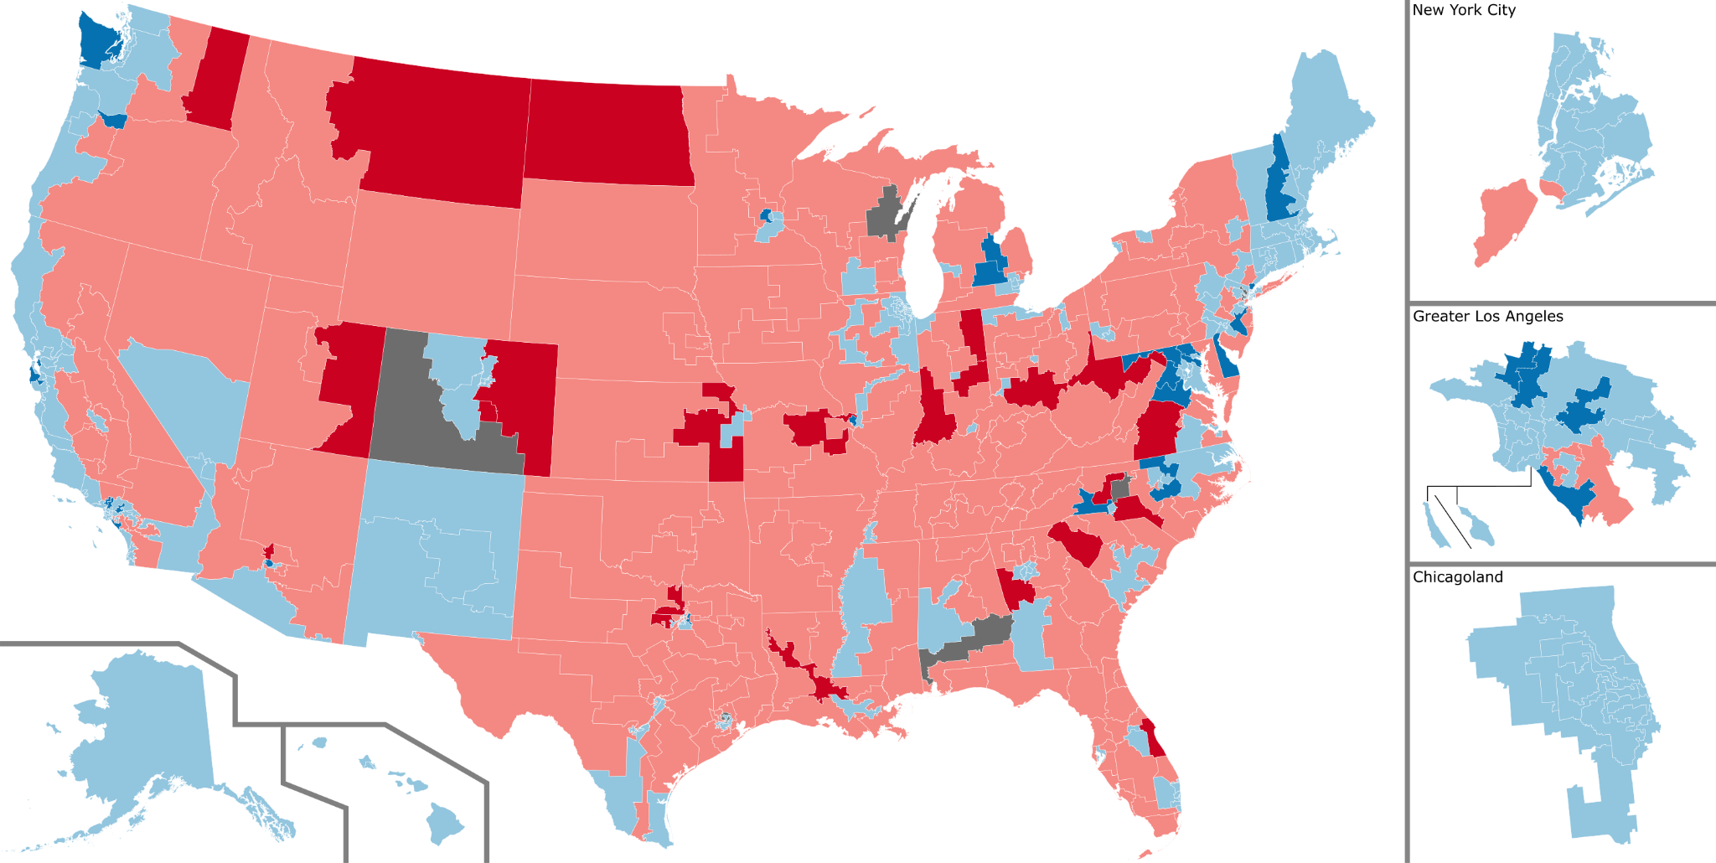
Regional Re-Alignment
1990
Today

Slide 35
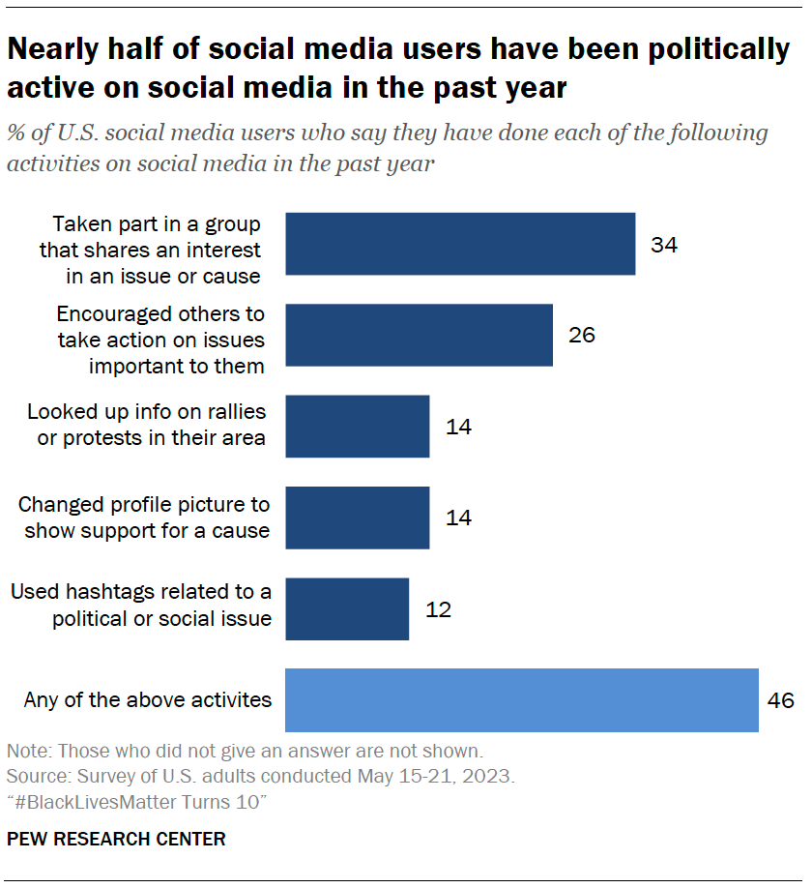
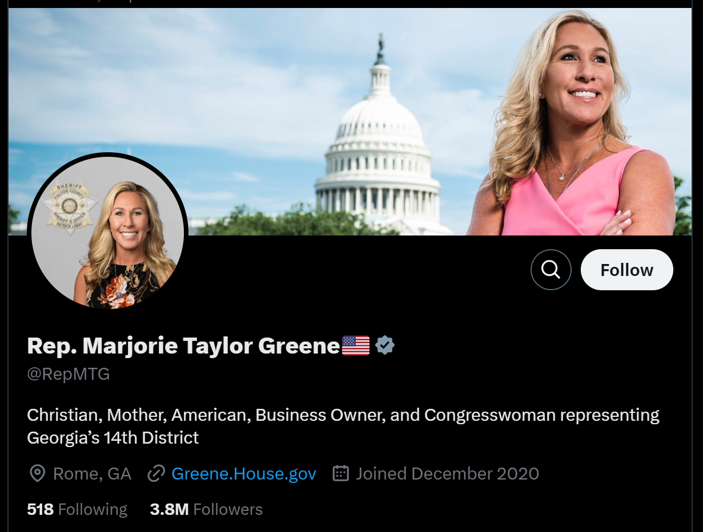
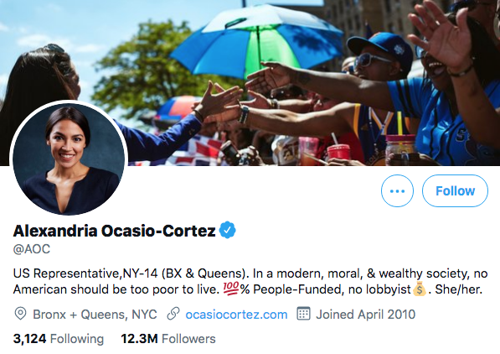
Nationalized Politics
“All politics is local.” – Former Speaker Tip O’Neill

Slide 36
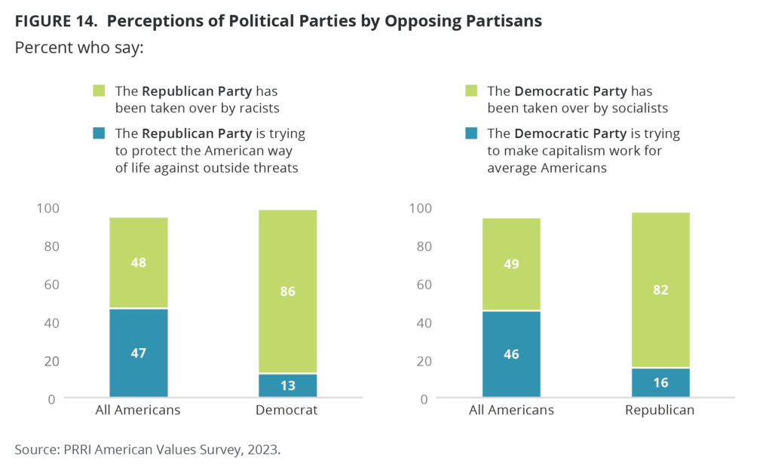
More Divided Electorate

Slide 37
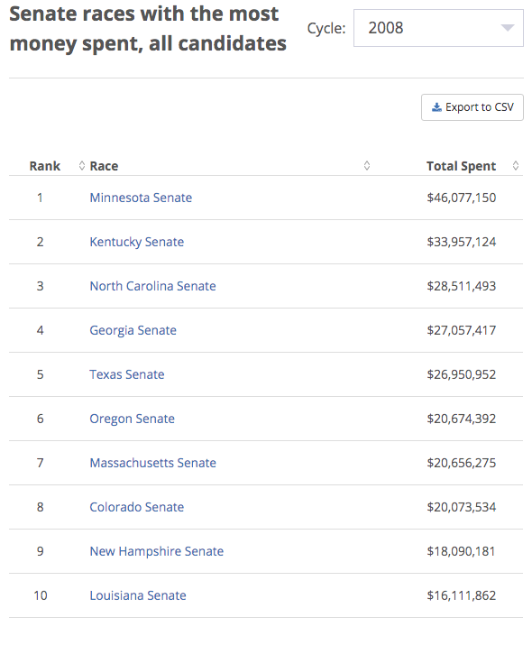
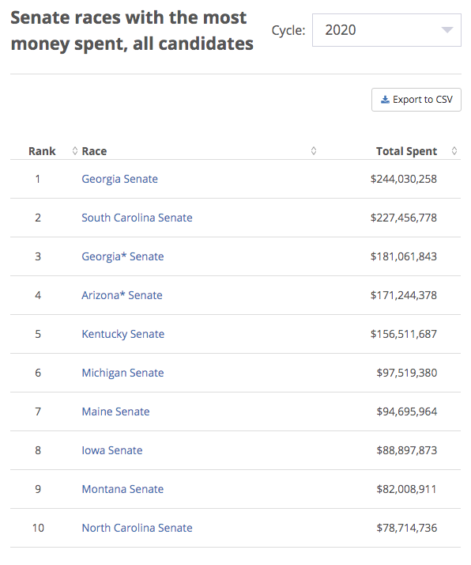
More Campaign Spending

Slide 38
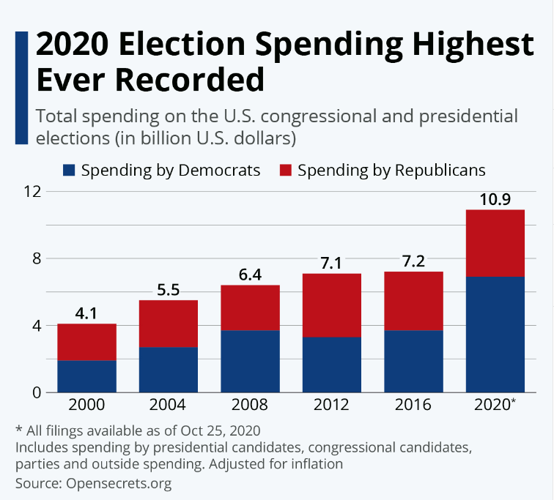
More Campaign Spending
$15.9B projected spending in 2024

Slide 39
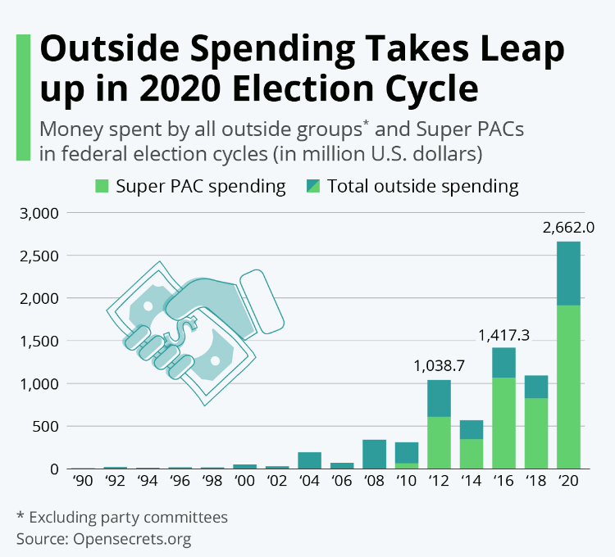
More “Dark Money”

Slide 40
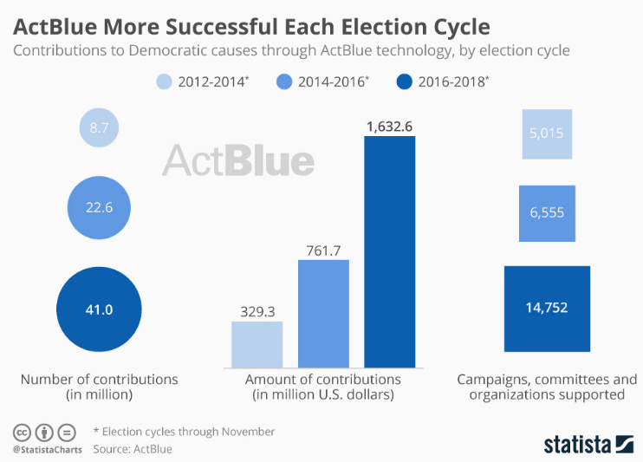
More Online Fundraising

Slide 41
What does this mean for
Nebraska Hospitals and our work?

Slide 42
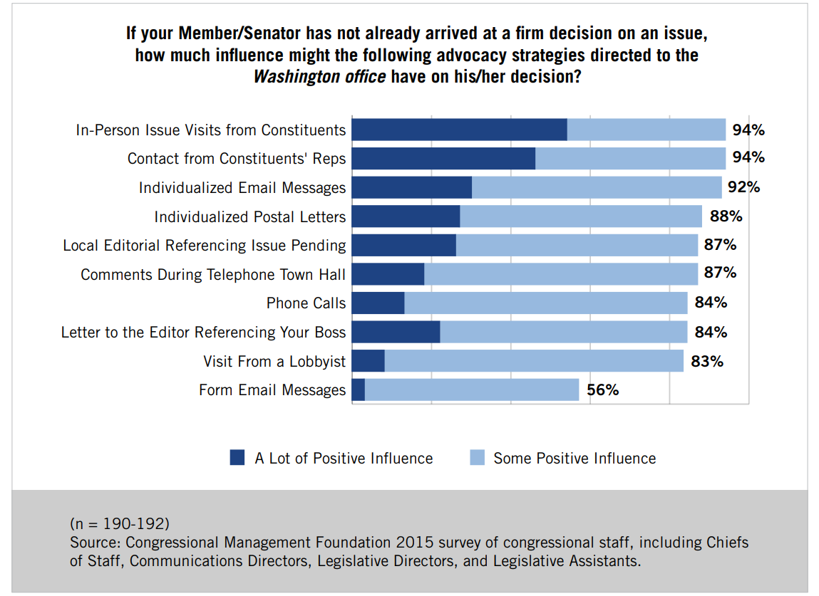
How Do You Breakthrough?

Slide 43
Other Key Takeaways
Health care policy is incredibly complex – we need to know what we want fixed/changed
We must have a shared message that is clear, consistent, and compelling
Need to mix stories with data to back it up
Need as many contacts with our federal representatives and staff as possible
NHA PAC & AHA PAC play an important role
Every hospital voice matters

Slide 44
2024 Election

Slide 45
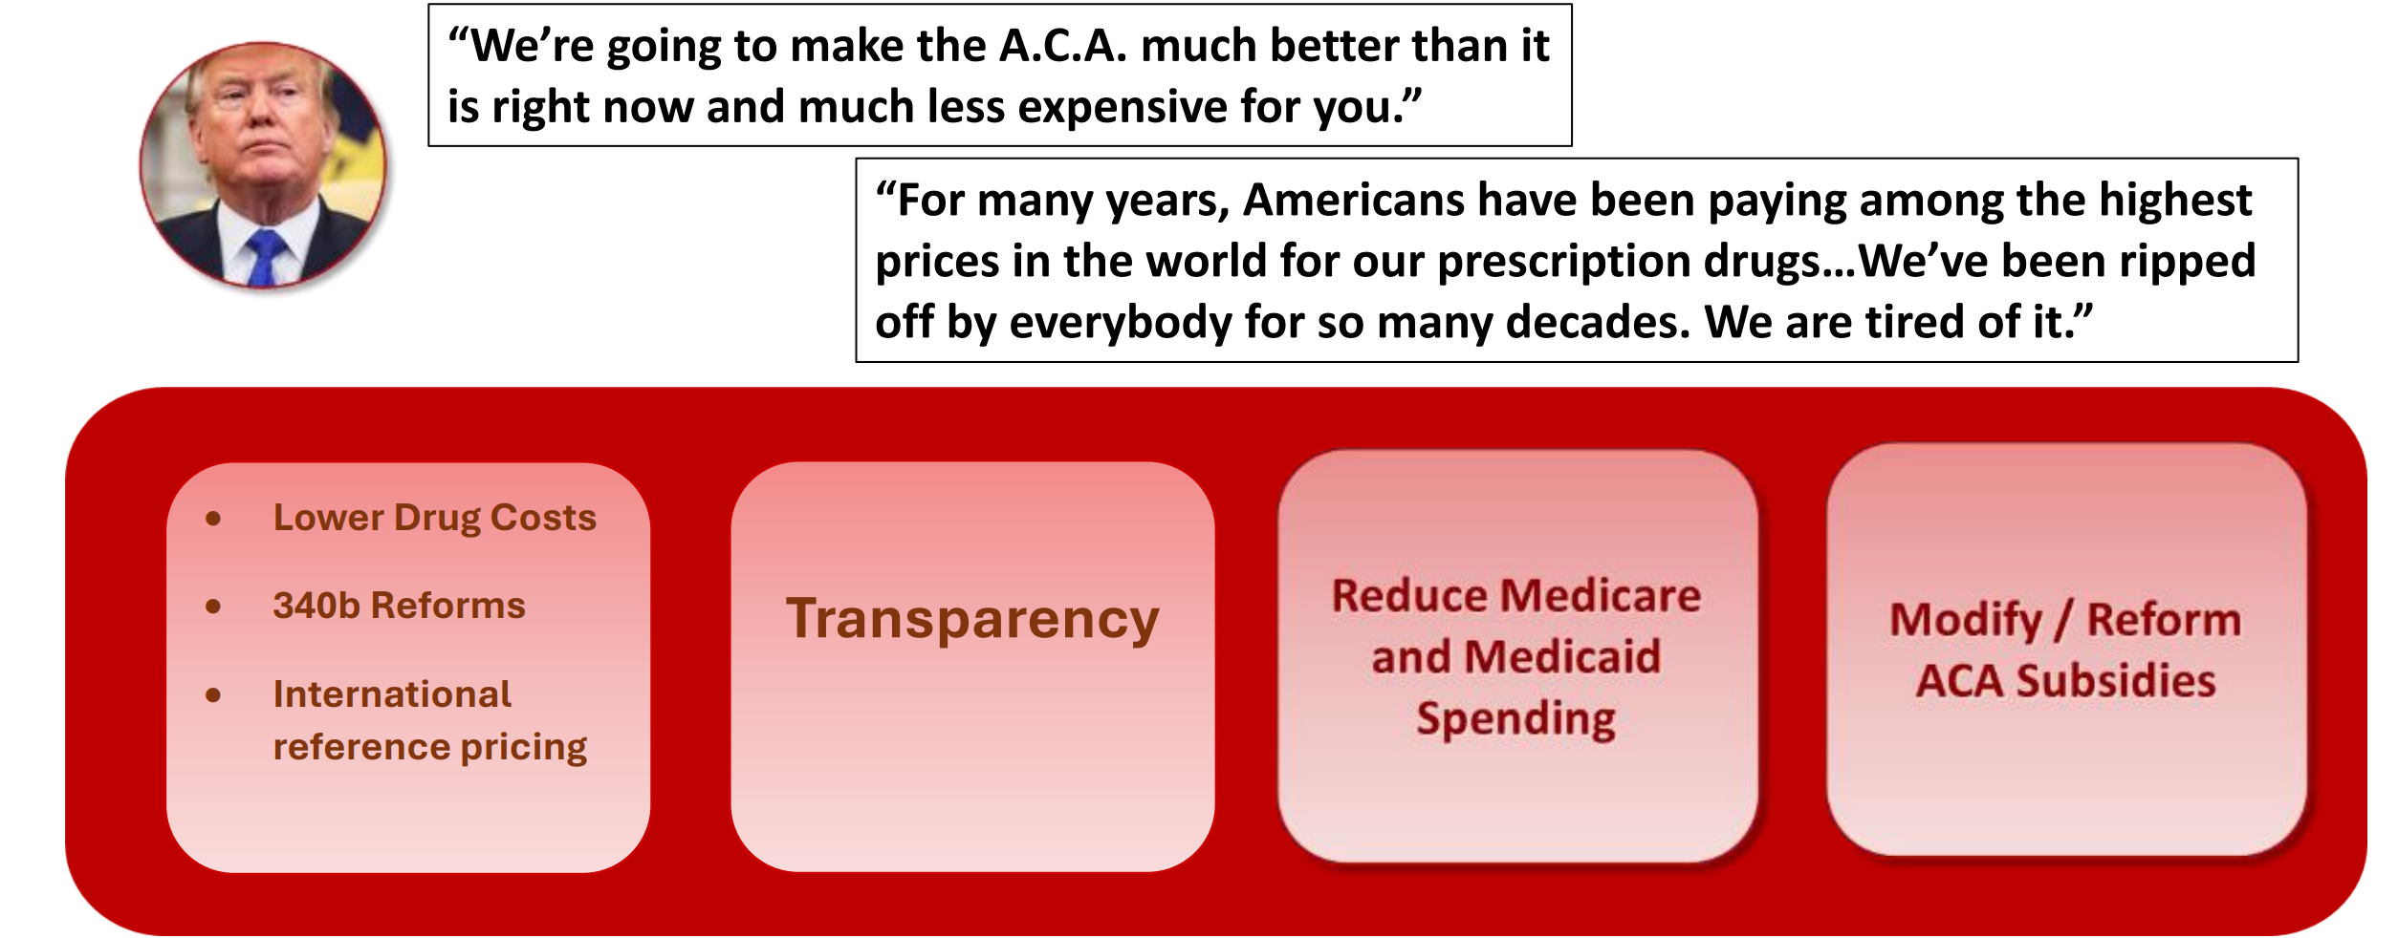
Trump Health Care Priorities

Slide 46
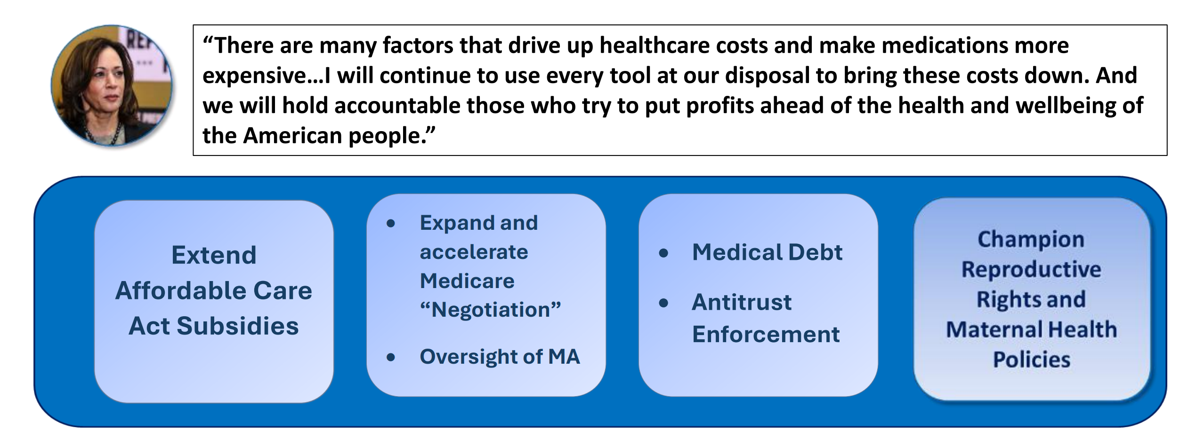
Harris Health Care Priorities

Slide 47
Looking Ahead to 2025
Debt Ceiling
Expiration of ACA coverage tax subsidies
Expiration of Trump tax cuts
Insolvency of Medicare Trust Fund
Social Security Trajectory

Slide 48
Questions & Discussion

